Slide 1
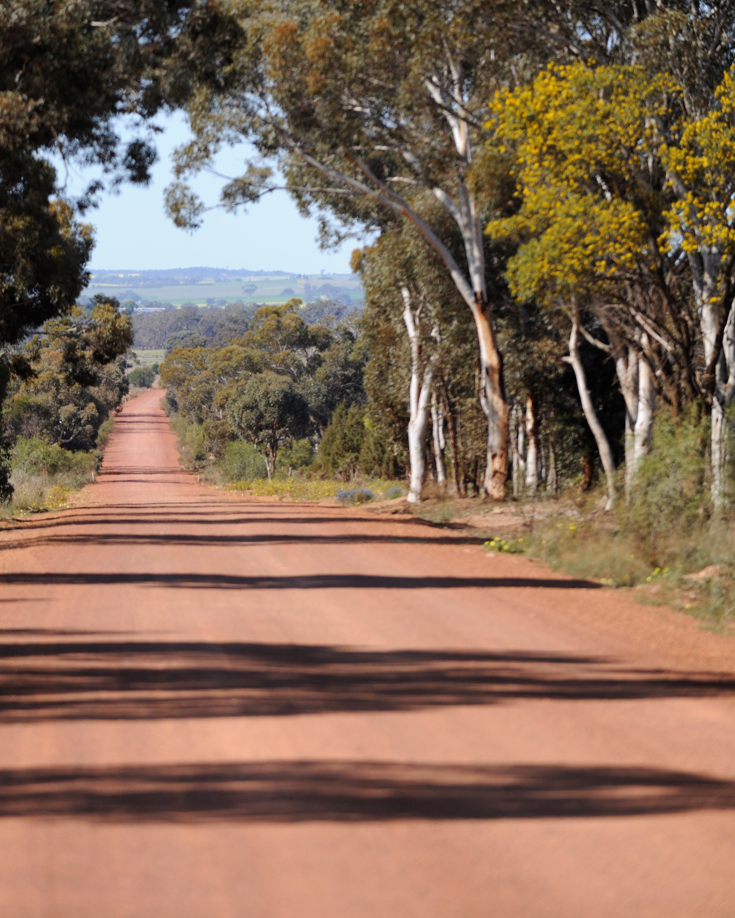
Roadside Vegetation
Management – Part 2
Meeting the regulatory requirements for activities affecting native vegetation in a road reserve
Guidance for Local Government
in Western Australia

Slide 2
Acknowledgement of Traditional Owners
WALGA acknowledges the continuing connection of Aboriginal people to Country, culture and community. We embrace the vast Aboriginal cultural diversity throughout Western Australia, including Boorloo (Perth), on the land of the Whadjuk Noongar People, where WALGA is located and we acknowledge and pay respect to Elders past and present.
Pictured left: Artwork by Jade Dolman, a young Whadjuk/Ballardong Nyoongar, Eastern Arrernte, Irish woman from Perth.

Slide 3
3
Part 2 Overview
What is native vegetation and the mitigation hierarchy
Environmental Protection and Biodiversity Conservation Act 1999 and the “Matters of National Environmental Significance”
Biodiversity Conservation Act 2016
&
Environmental Protection Act 1986:
Exemptions
Referrals
Clearing Permits
Other approvals
Look out for tips
Photo: WALGA

Slide 4
Native vegetation
Under the Environmental Protection Act 1986, native vegetation means:
all types of indigenous vegetation, including those found in aquatic and marine environments
dead vegetation (unless declared by regulation to be excluded)
intentionally sown, planted or propagated vegetation which is required by law
planted vegetation which was partly or wholly funded by a third party for the purposes of biodiversity or land conservation.

Slide 5
What is clearing?
Clearing includes any activity that causes substantial damage to native vegetation, including through:
Killing or removing of native vegetation
Severing or ringbarking of trunks or stems
Draining or flooding of land
Burning of vegetation
Grazing
Or any other activity that kills or damages native vegetation.
Pruning is not considered ‘clearing’ under the EP Act, provided the main trunk or stem is not severed and it does not kill or cause significant damage to the vegetation.

Slide 6
AVOID
MINIMISE
Mitigation hierarchy
Before designing projects that will require native vegetation clearing, consider:
Can upgrades within the maintenance zone meet the objectives?
What alternative engineering solutions are available?
Have all possible locations been considered?
Do you have in place strategies or standards for management of threats (conservation plans, weeds and dieback management plans)
REHABILITATE
OFFSET
Document these considerations e.g. minutes of meetings, results of comparative analyses (cost/benefit) – you will need these to support a clearing application for any

Slide 7
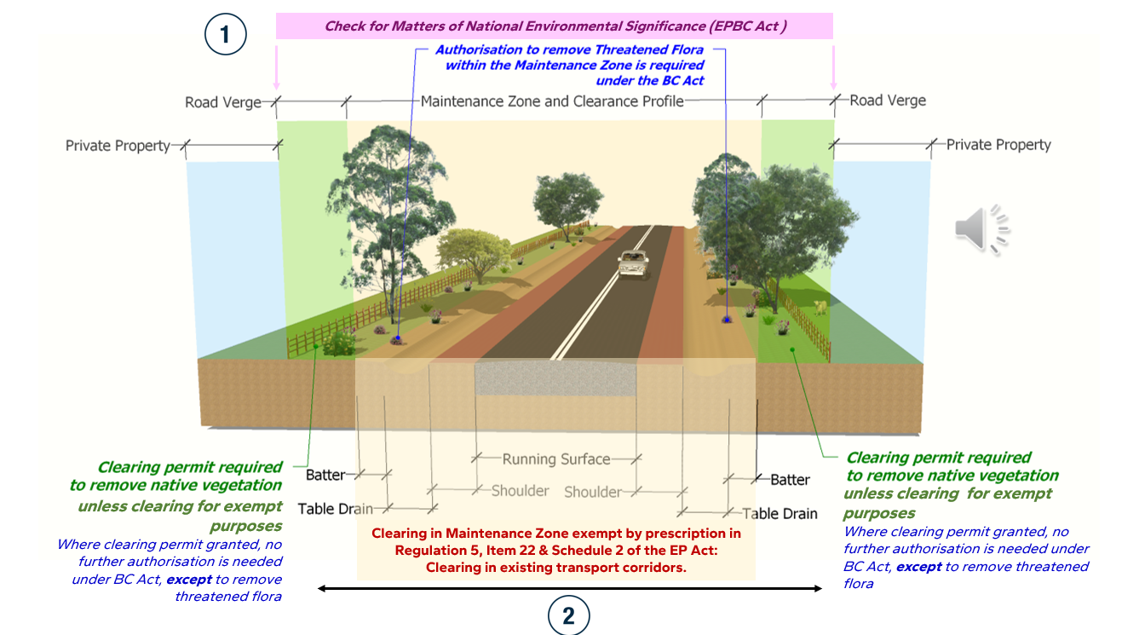

Slide 8
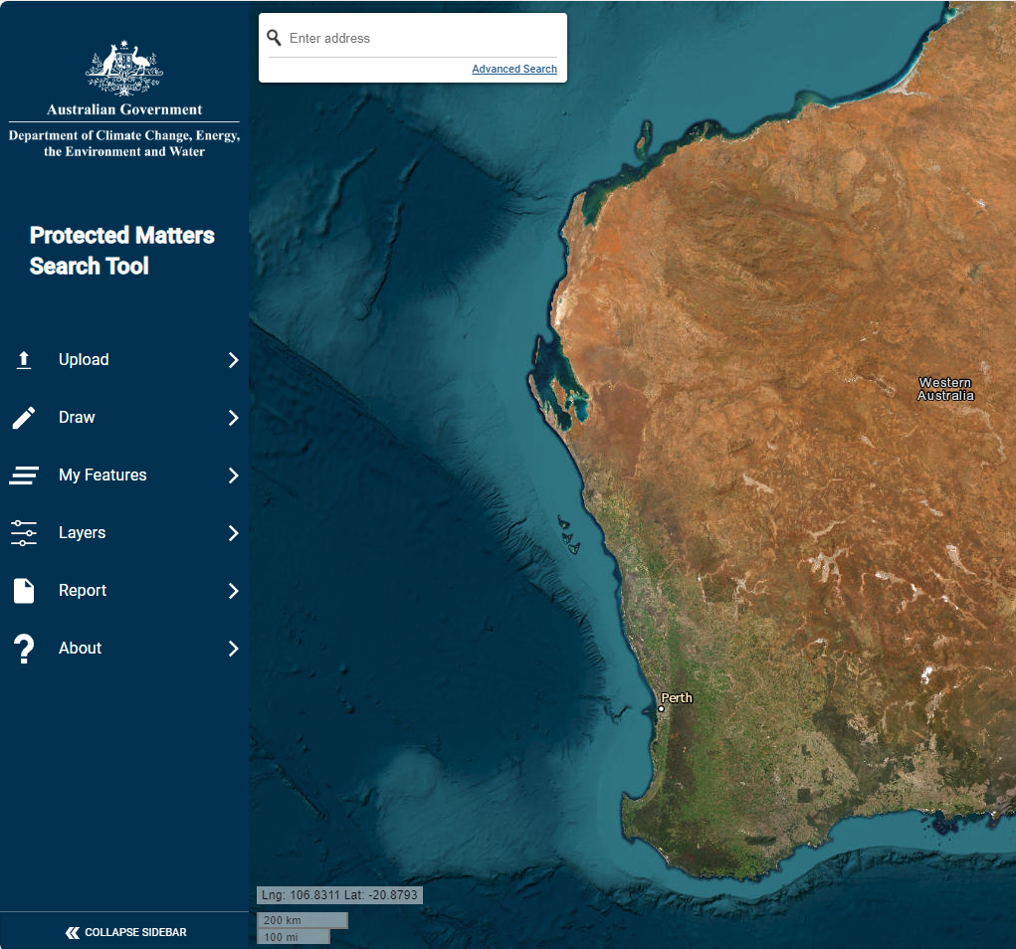
How to determine whether an activity is likely to have a significant environmental impact on a Matter of National Environmental Significance?
Matters protected under the Environmental Protection and Biodiversity Conservation Act 1999 that might be impacted by activities in road reserves:
Wetlands of international importance (Ramsar Wetlands)
Listed threatened species and ecological communities
Listed migratory species
Use the Protected Matters Search Tool to identify any potential MNES in the proposed project area.
Follow guidance in the Significant Impact Guidelines 1.1-Matters of National Environmental Significance
For listed MNES, refer to information available in the Species Profile and Threats Database such as:
Approved conservation advice
Recovery plans for listed species and ecological communities

Slide 9
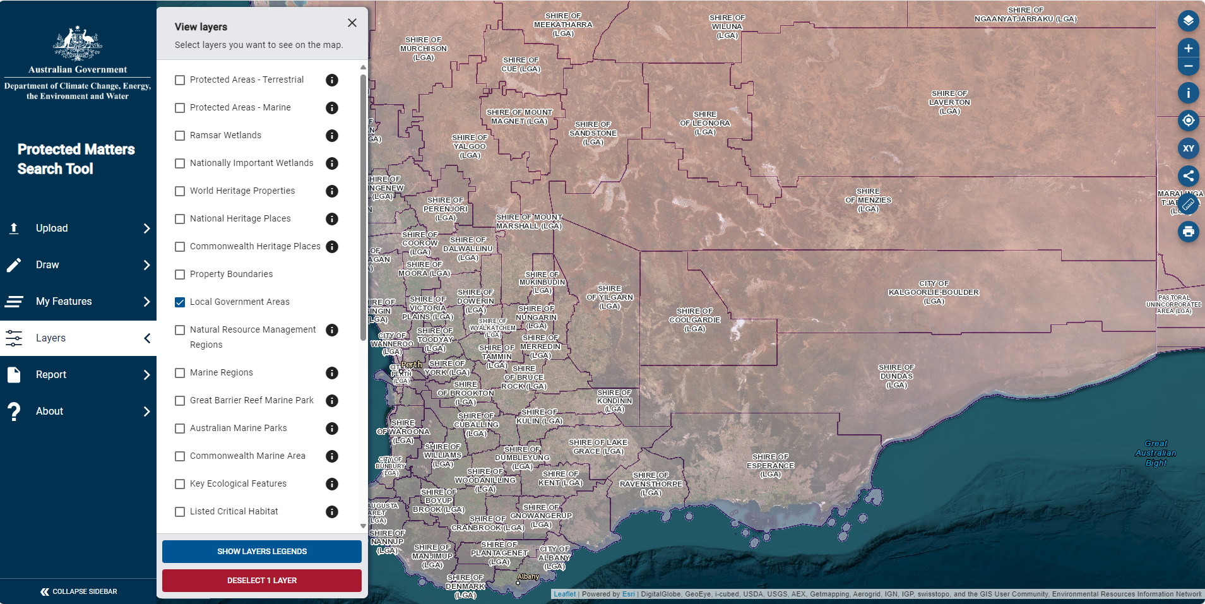
Access via https://www.dcceew.gov.au/environment/epbc/protected-matters-search-tool

Slide 10
If determined that an activity is likely to have significant impact on MNES
Follow the referral process under the EPBC Act
When the Commonwealth Minister for the Environment determines that the clearing action is a ‘controlled action’, you must submit a clearing permit application under Part V of the Environmental Protection Act 1986.
Information on clearing approval process under the Commonwealth and the State process is available in:
A guide to native vegetation clearing processes under the assessment bilateral agreement
Clearing Regulations fact sheet 25: Native vegetation clearing process under the bilateral agreement
Talgomine Reserve Road, Shire of Nungarin. Photo: WALGA
Notes:
Due to the high levels of historical clearing in large parts of the SW of WA, in many areas vegetation in road reserves retains the last examples of original vegetation, habitat for local wildlife.

Slide 11
Approvals under the Environmental Protection Act 1986
In Western Australia, clearing of native vegetation is regulated under the Environmental Protection Act 1986 (EP Act) and the Environmental Protection (Clearing of Native Vegetation) Regulations 2004 (Clearing Regulations)
Clearing of native vegetation must be authorised by
Clearing permit
Exempt under Schedule 6 of the EP Act
Exempt under Clearing Regulations & outside Environmentally Sensitive Areas
Referral approval (under s.51DA of the EP Act)
OR
OR
OR

Slide 12
Environmentally Sensitive Areas
Areas classified as Environmentally Sensitive Areas are declared in the Environmental Protection (Environmentally Sensitive Areas) Notice 2005.
Environmentally Sensitive Areas (ESAs) include:
a declared World Heritage Property
an area that is included on the Register of the National Estate
defined wetland and the area within 50m of the wetland
the area covered by vegetation within 50m of rare flora
the area covered by a threatened ecological community
Bush Forever site
Areas covered by The Environmental Protection (Western Swamp Tortoise) Policy 2002
Guidance on Environmentally Sensitive Areas is provided on the DWER website.
https://www.der.wa.gov.au/your-environment/environmentally-sensitive-areas

Slide 13
Approvals under the Biodiversity Conservation Act 2016
Activities that affect species or ecological communities listed under the Biodiversity Conservation Act 2016 (BC Act) require licences or authorisations administered by the Department of Biodiversity, Conservation and Attractions (DBCA).
ESA Markers help with locating sections of a road reserve where threatened flora occurs.
Activities involving the taking of flora or fauna and the disturbing of fauna that are approved under the Environmental Protection Act 1986 do not require further approval under the BC Act, if they are undertaken in accordance with any biodiversity conservation conditions that are applied to an authorisation. Except, where the flora to be taken is threatened flora, an authorisation to take threatened flora under section 40 of the BC Act will also be required.
To assess the likelihood of threatened flora presence in local road reserves or other Local Government managed lands:
Check internal records – DBCA notifies land managers about threatened flora locations.
Upload DBCA’s Threatened and Priority Flora (DBCA-046) mapping data into your internal mapping viewer or preview the data on the public portal - go to www.datawa.wa.gov.au
Request the latest update from DBCA’s Species and Communities unit

Slide 14
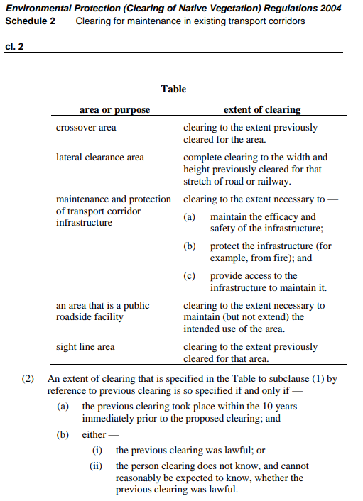
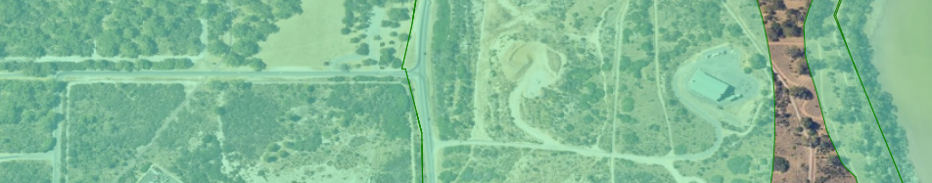
Clearing exemptions for maintenance in existing transport corridors:
Schedule 6 exemptions
Regulation 5, Item 22 & Schedule 2
While Clearing Regulation exemptions do not apply in an environmentally sensitive areas (ESA), an area that would otherwise be an ESA is not an ESA to the extent it is in a maintenance zone of a road or railway. A maintenance zone is an area that has been lawfully cleared.
Read: A guide to the exemption for clearing native vegetation for maintenance in existing transport corridors (DWER, 2015)

Slide 15
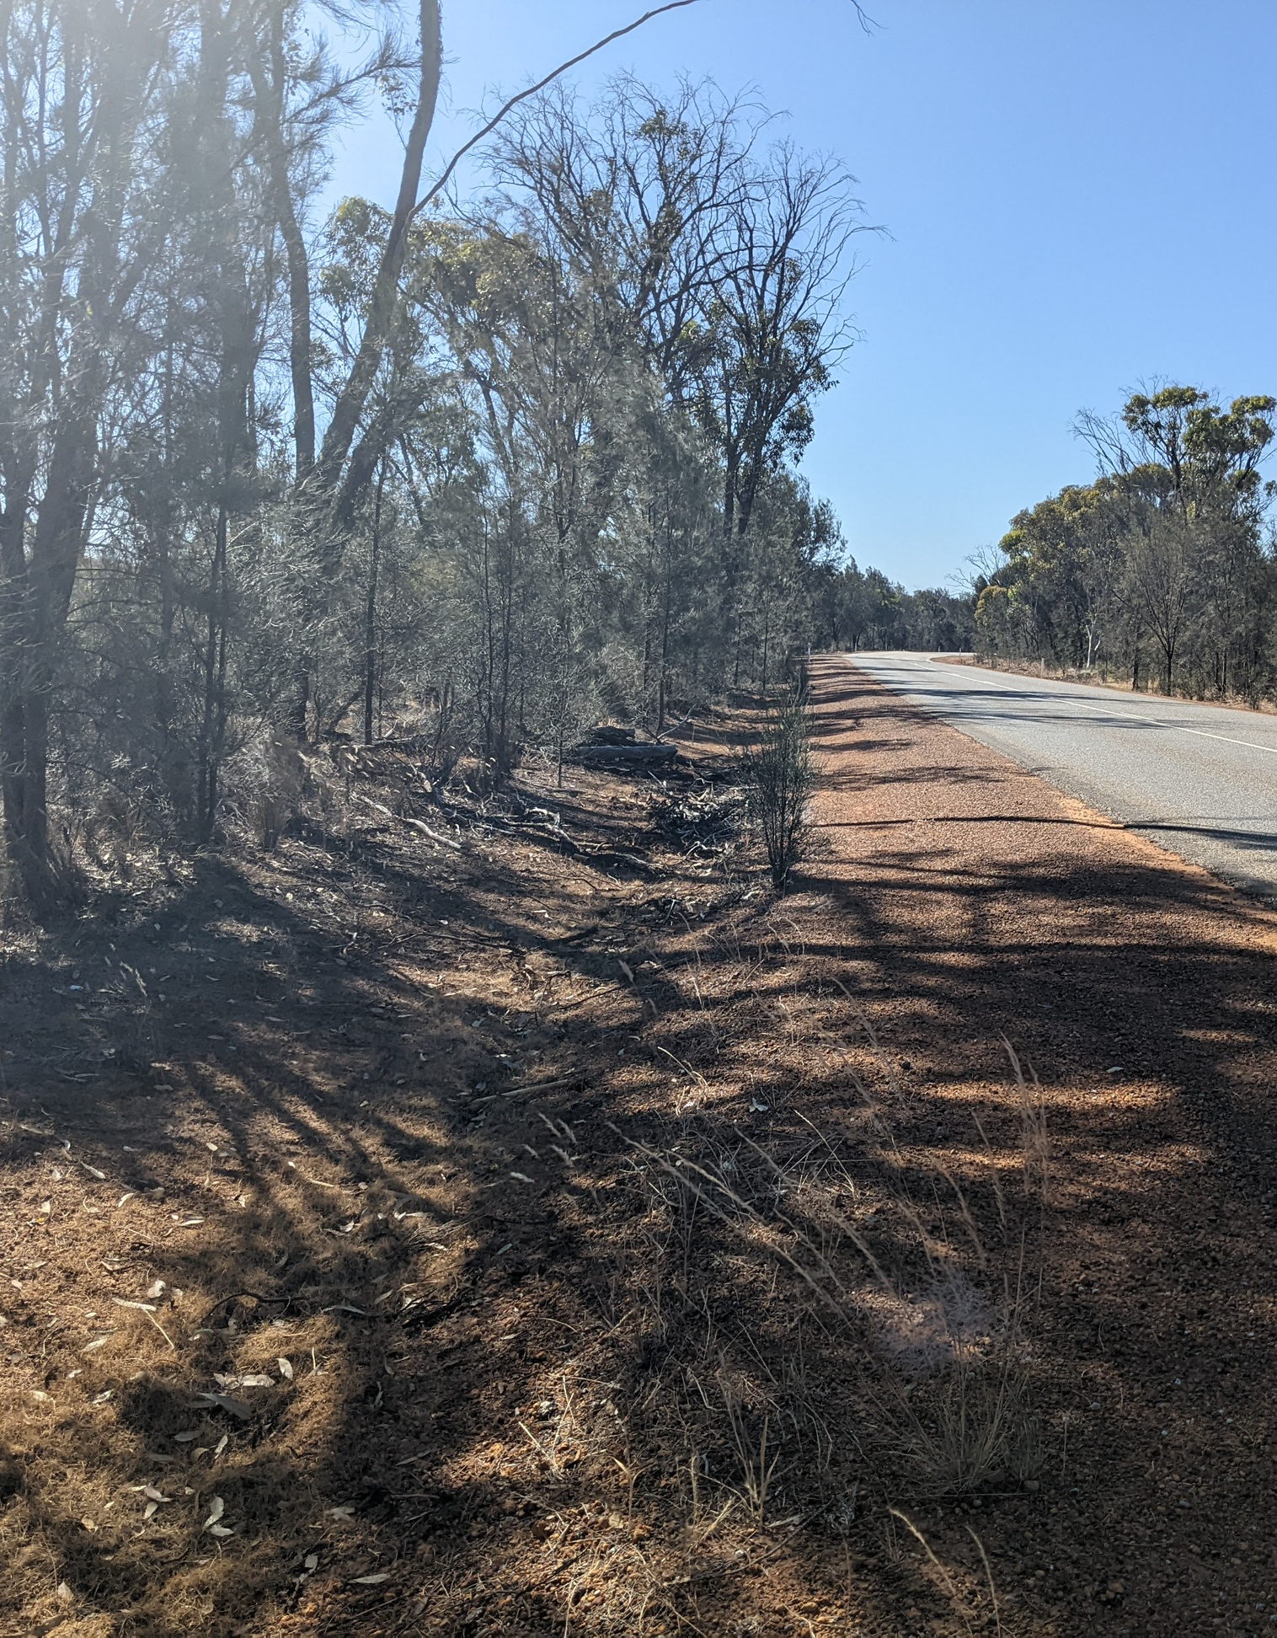
‘Maintenance zone’ examples
Removing the emerging sheoaks from the existing roadside drain do not require a clearing permit
Example of a maintenance zone without defined drain and backslope. Clearing exemptions only apply to the width of cleared area
Maintenance of water diversion into roadside is exempt but to add new diversion nodes will require a clearing permit.

Slide 16
Exemptions relating to clearing in road reserves continued
To prevent imminent danger
Regulation 5, Item 2: “Clearing resulting from accidents or to reduce danger’
Regulation 5, Item 3: “Clearing for fire hazard reduction”
Fire hazard reduction burning outside of prohibited or restricted periods
Done in such a way as to minimize long-term damage to the environmental values of the vegetation.
Regulation 5, Item 11: “Clearing along a fence line – Crown land”
Regulation 5, Item 21: “Clearing for a temporary bypass road” (emergency diversion access track)
Regulation 5, Item 21A: “A clearing for a crossover” (from a road to a property and any associated sight line areas)
Read:
DWER’s Guide 3: A guide to burning under the native vegetation clearing provisions
DBCA’s fire notes for priority species and communities
These exemptions do not apply in an environmentally sensitive areas.
Notes:
Due to the high levels of historical clearing in large parts of the SW of WA, in many areas vegetation in road reserves retains the last examples of original vegetation, habitat for local wildlife.

Slide 17
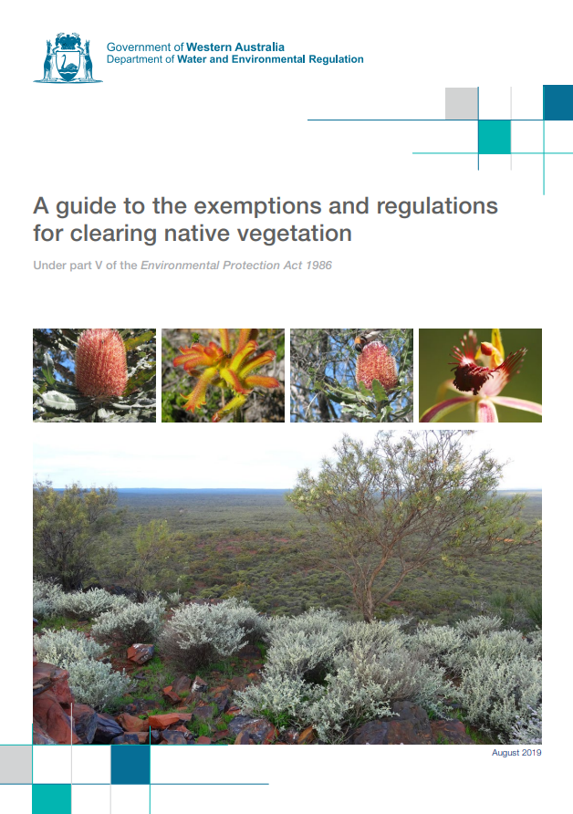
Guidance document
Available through the Department of Water and Environment Regulations website – check for updates

Slide 18
Referrals
The referral stream of clearing assessments is for:
very low impact clearing
where no management conditions are needed
can be completed within 2 years.
satisfy all the criteria specified under section 51DA of the EP Act.
Referrals process
No application fee
No public consultation
Short determination time

Slide 19
Referrals criteria
The area to be cleared (the area) is small relative to the total remaining vegetation (thresholds and criteria used) -
Within the region in which the area is situated; or
Of the ecological community of which the vegetation proposed to be cleared forms part;
(b) There are no known or likely significant environmental values within the area
(c) The state of scientific knowledge about vegetation within the region in which the area is situated is adequate; and
(d) Conditions will not be required to manage environmental impacts.
For more information on how use the clearing referral process, refer to the DWER
Guideline - Native vegetation clearing referrals (www.wa.gov.au).

Slide 20
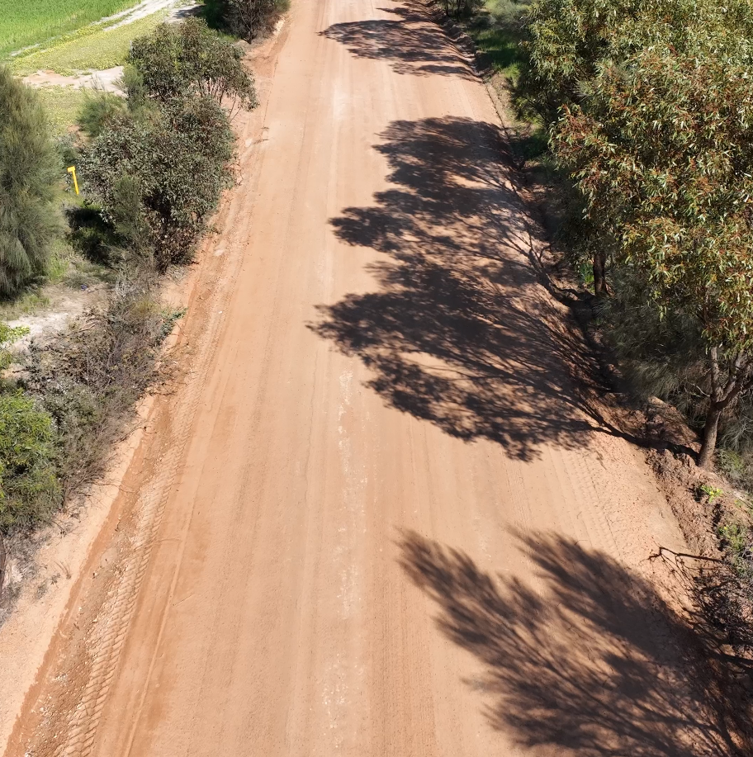
Clearing permits
Area permit – clearing for a specified area, typical duration of two years
Purpose permit – clearing of different areas from time to time for a purpose specified in the application, typical duration of five years
Application fees apply (use on-line clearing permit fee calculator tool )
Subject to 21 days public consultation period
Decisions are open for appeals
Photo: WALGA

Slide 21
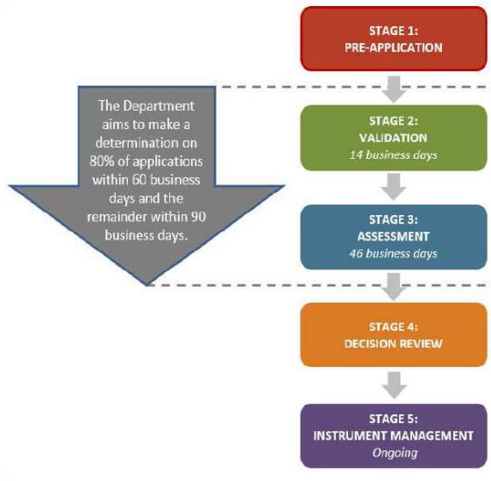
Clearing permit process
Meet with DWER to discuss application
Application submitted
Decision issued and advertised
Read the DWER’s Guide 2: Guide to the assessment of applications to clear native vegetation
Source: DWER, 2021

Slide 22
Other approvals
Rights in Water and Irrigation Act 1914
Country Areas Water Supply Act 1947

Slide 23
Clearing permit application checklist
Desktop assessment of potential environmental values completed
Have you checked DWER guidance?
Pre-application meeting with DWER staff (survey requirements and their timing; requirements for supporting documentation, type of clearing permit to use, other approvals that might be needed)
Have avoidance and impact minimisation measures been documented? E.g. design options, weeds/dieback management, rehabilitation plan meets DWER’s guidelines, ect.
Could the proposal be considered as part of a strategic permit application?
Does biological site information meet the requirements?
Have the clearing area been mapped? E.g. do you have a shape file?
Have other approvals been secured?
Have offset options/feasibility been considered?
Have the application fee been calculated correctly and paid?
Have the application been signed off by an authorised officer (Chief Executive Officer or their delegate)

Slide 24
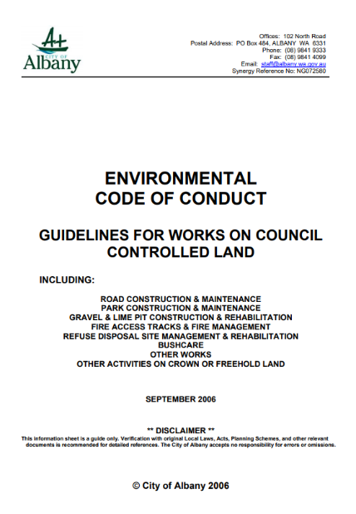
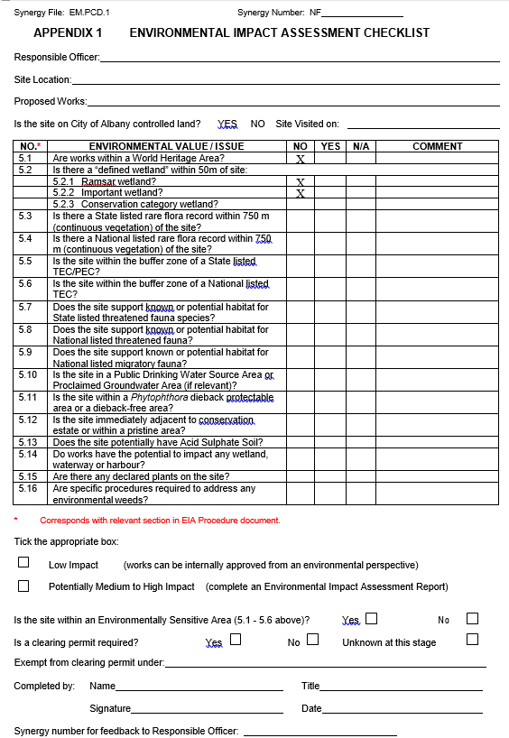
Example: Environmental Impact Assessment checklist
The City of Albany adopted an internal procedure to guide the process for identifying potential environmental impacts of works on City managed lands: ENVIRONMENTAL CODE OF CONDUCT for works on Council controlled lands.
This document includes the City’s ‘Environmental Impact Assessment Checklist’ and a ‘Statement of Compliance’

Slide 25
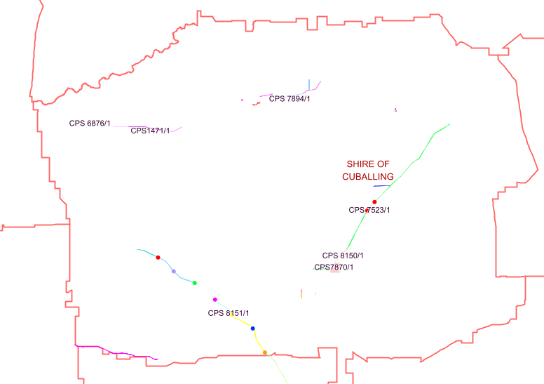
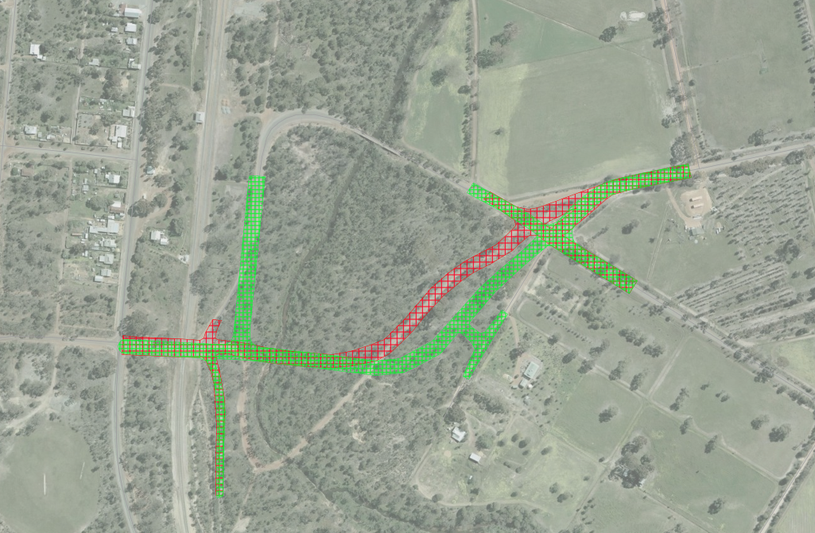
Example: Shire of Cuballing Strategic purpose clearing permit
Authorized to clear between 14 August 2020 – 14 August 2030 (Permit duration till 14 August 2035)
11 distinct project areas across the Shire, totaling 16.805ha of clearing footprint
Offset: 41.68ha within two Shire managed reserves
Management conditions:
Dieback & weed control
Fauna management – Black cockatoos and red-tailed phascogales
Flora – demarcate and avoid priority flora
Threatened and priority flora
Vegetative material and topsoil retention, revegetation & rehabilitation (1.57ha)
Annual Reporting (on or before 30 June each year)

Slide 26
Example: Shire of Cuballing Strategic purpose clearing permit
Benefits
Increased certainty around timing of project delivery
A single permit covering road projects and gravel requirements to accommodate these
Simplified administration, including an offset package – one permit vs multiple permits for individual projects
Significant cost saving on clearing permit fees ($4,000 vs $27,800)
Due to potentially significant lead times – use for projects to be delivered within 2-5 years timeframe
Undertake as many flora/fauna surveys as feasible to support the clearing permit application (but do not have to do them for all projects within the permit)
Group projects with similar design requirements to minimize the need for clearing permit amendments due to design changes affecting the clearing footprint
Consider an offset bank

Slide 27
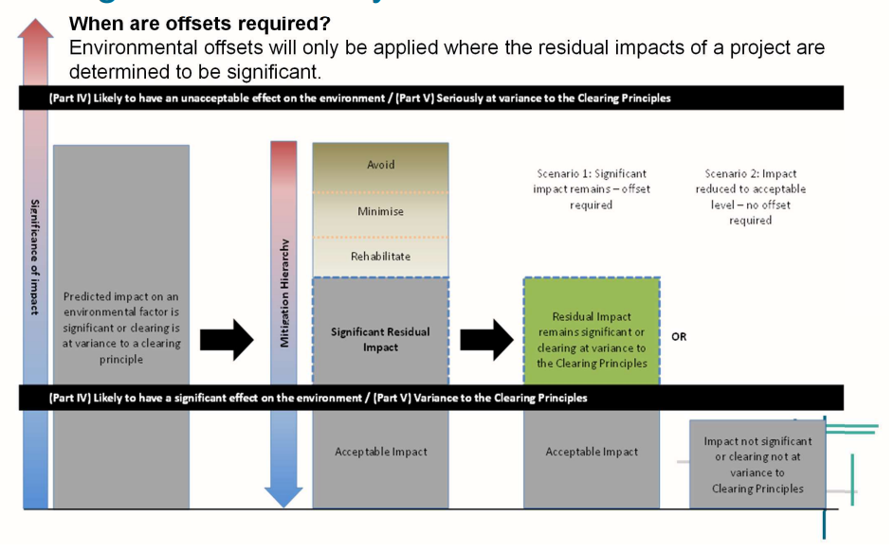
Offsets
Applied when clearing at variance with one or more of the clearing principles
Guided by the State’s offsets framework (Policy, Offsets register, Guidelines and Offsets metric)
Include:
Protecting and maintaining vegetation on land
Rehabilitation
Monetary contribution to the State’s offset fund
Installation of alternative nesting structures
Source: DWER, 2021

Slide 28
Summary – Meeting regulatory requirements
28
Legislation
Mitigation hierarchy
Exemptions
Clearing permit
Environmental Protection Act 1986
Biodiversity Conservation Act 2016
Environmental Protection and Biodiversity Conservation Act 1999
Other
Avoid
Minimise
Rehabilitate
Offset
Road infrastructure maintenance activities are exempt
Some exemptions do not apply in Environmentally Sensitive Areas (ESAs)
Refer to DWER Guidelines
Engage with DWER prior lodging a clearing application
Consider strategic permits

Slide 29
Disclaimer
At WALGA, we've made every effort to ensure that the material contained on our website is accurate, current and reliable at the time it was created or last modified.
While the material on this resource is compiled with due care, WALGA does not warrant or accept liability with regards to the accuracy or completeness of the material. As such, no reliance should be made by the user on the material who should carefully assess the relevance and accuracy of that material, including seeking confirmation from the originating body.
The information delivered to you via any externally hosted website is produced and managed by the website owner. All care has been taken to ensure validity of these external sites, however WALGA cannot be held responsible for any misrepresentation of information found on any external websites.
If you wish to clarify anything about this site or have concerns regarding your privacy, please contact us.
Copyright
All material that appears in this presentation, including content, graphics and audio is protected by the operation of the Copyright Act 1968, and is owned by the WALGA unless otherwise referenced as being from another source. Materials contained here can be reproduced for personal and non-commercial use, without permission providing it remains unaltered in its original form. Should you wish to reproduce material that is for commercial or non-personal use, you can request permission to do so by contacting us.
Contact
For further information email to environment@walga.asn.au
Resources
To download resources supporting local biodiversity planning visit WALGA’s website
To download mapping data, go to
Western Australian Local Government Association - Organisations - data.wa.gov.au
This Project is supported by funding from the Western Australian Government’s State NRM Program

