Slide 1
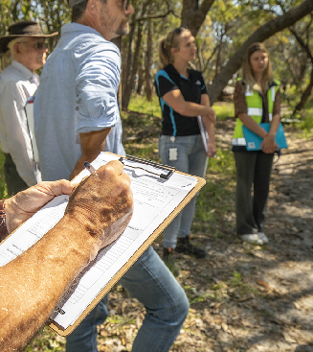
Natural Area
Initial Assessment
Templates
An introduction to a standardised approach to collecting
Information on natural areas for local biodiversity
planning.
2025

Slide 2
Acknowledgement of Traditional Owners
WALGA acknowledges the continuing connection of Aboriginal people to Country, culture and community. We embrace the vast Aboriginal cultural diversity throughout Western Australia, including Boorloo (Perth), on the land of the Whadjuk Noongar People, where WALGA is located and we acknowledge and pay respect to Elders past and present.
Pictured left: Artwork by Jade Dolman, a young Whadjuk/Ballardong Nyoongar, Eastern Arrernte, Irish woman from Perth.

Slide 3
Overview
What are NAIA Templates?
Why use them?
How to complete them?
How to use them?
Image: City of Bunbury, Amangu Country

Slide 4
What are NAIA Templates?
NAIA Templates collect information on the ecological values of natural areas to inform their management and conservation priorities
Where to use NAIA Templates?
Natural areas – areas that contain native species and communities in a relatively natural state and hence contain biodiversity:
Areas of native vegetation, including revegetated sections
Vegetated or open water bodies and waterways
Springs
Rock outcrops
Caves
Coastal dunes or cliffs
Image: City of Joondalup reserve mapping (Source: City of Joondalup Online Intramaps,, January 2024)

Slide 5
What are NAIA Templates?
Where not to use NAIA Templates?
Parkland cleared
Solely revegetated or reconstructed vegetation
Image: City of Joondalup reserve mapping (Source: City of Joondalup Online Intramaps,, January 2024)

Slide 6
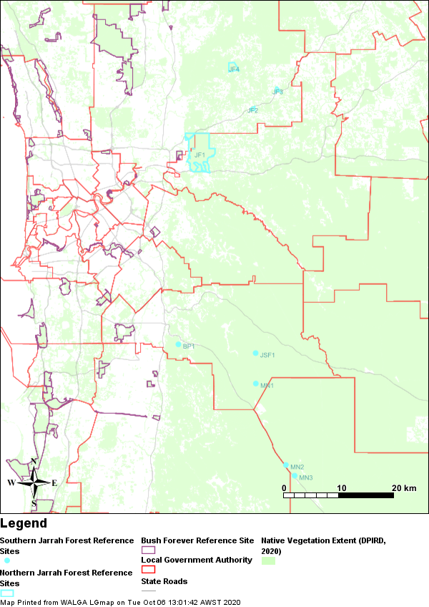
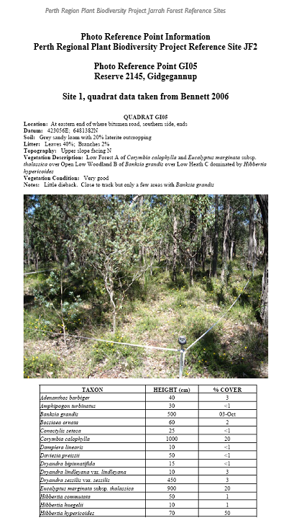
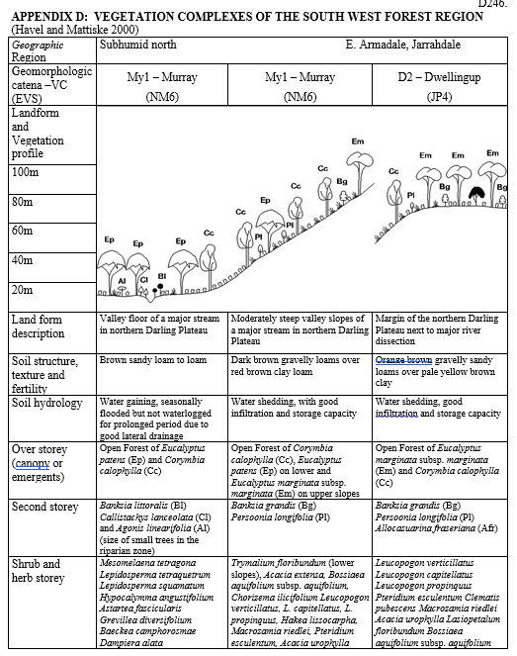
Reference Sites
Download from:
https://catalogue.data.wa.gov.au/dataset/perth-plant-communities-reference-sites

Slide 7
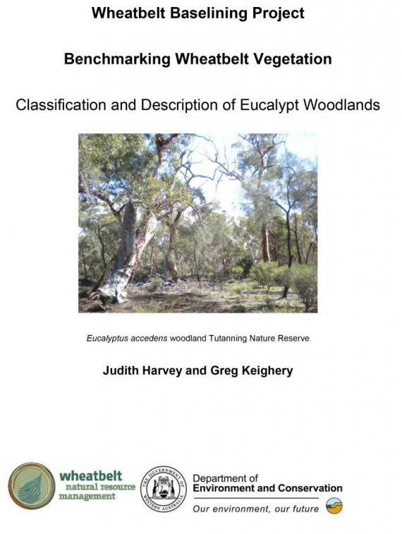
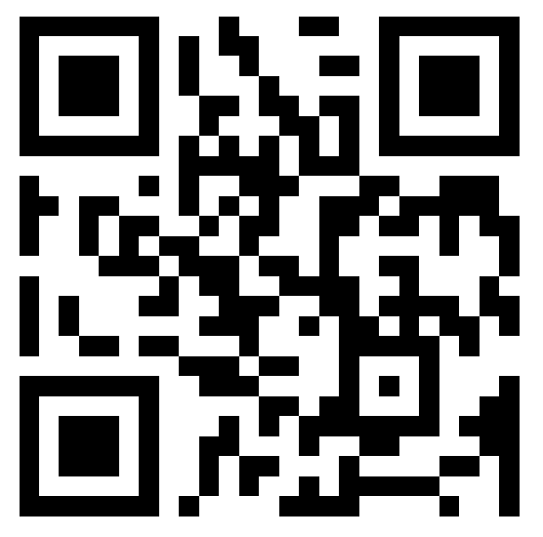
Other References
To assist with determining if specialist surveys are required to assess whether remnant vegetation might be considered Eucalypt Woodland of the Western Australian Wheatbelt TEC, Wheatbelt NRM has developed an online tool to assist with identification of potential areas of the Eucalyptus woodland of WA Wheatbelt threatened ecological community (TEC). The tool uses the defined in the TEC’s approved conservation advice, and ESRI’s Survey123 to guide assessment of remnant vegetation for a patch, or for roadside vegetation.
Scan this QR Code to access the Wheatbelt Woodlands Survey. Instructions on how to use this tool can be downloaded from https://www.wheatbeltnrm.org.au/sites/default/files/Poster - Healthy Environments - WWTA - Flyer TEC Tool.pdf.
The tool is not to be used as a definitive indicator for TEC presence/absence but rather as a guide to whether further survey effort is warranted.
Download from:
https://library.dbca.wa.gov.au/static/FullTextFiles/071385.pdf

Slide 8
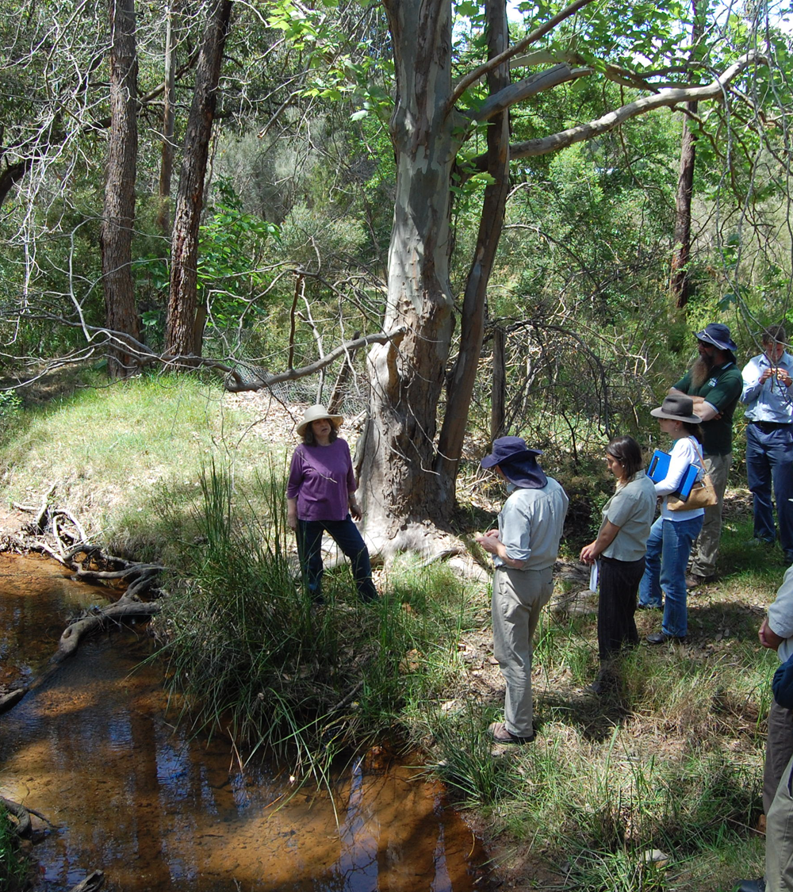
Why use NAIA Templates?
An information collection standard as part of a Local Planning Policy for Biodiversity Conservation in situations when development is proposed for land containing natural areas.
Assessing natural areas on private lands that may be eligible for private land conservation incentives.
Identify locally significant natural areas that require formal legal protection
Inform management of natural areas under Local Government control.

Slide 9
NAIA Template records in the Regional Database
Example: Shire of Manjimup reserves’ 2007 assessment summary
Priority Rank | Area Name | Suburb | Rank Criteria | Viability Score | Area (ha)
1 | R23740; Northcliffe Forest Park - North | NORTHCLIFFE | 1A | 21.28 | 108.28
2 | R19787; Broke Inlet | WALPOLE | 1A | 20.7 | 40.47
3 | R36421; Walpole Foreshore | WALPOLE | 1A | 20.5 | 11.81
4 | R13499; Wheatley Coast Road | QUINNINUP | 1A | 18.5 | 16.52
5 | R15663; Quinninup | QUINNINUP | 1A | 18.08 | 40.05
6 | R9616, Black Georges Road | MANJIMUP | 1A | 16.5 | 15.9
7 | R19552; Rae Park | MANJIMUP | 1A | 15.7 | 25.25
8 | R24937; Mottram Street Reserve | MANJIMUP | 1A | 14.1 | 13.48
9 | R21374; O'Connor St | MANJIMUP | 1A | 13.9 | 2.496
10 | R23904; Lefroy Street Reserve | PEMBERTON | 1A | 11.96 | 1.32
11 | R4150; Balbarrup Road | MANJIMUP | 1A | 11 | 5.44
Available via:
https://spatial.agric.wa.gov.au/naia/code/default.asp

Slide 10
NAIA Templates consist of four parts:
Natural Area Initial Desktop Assessment Template
Natural Area Initial Field Assessment A Template
Natural Area Initial Field Assessment B – Significant Species and Communities Template
Natural Area Initial Assessment Summary Template
Appendices
Skill level matrix for natural area assessment
Growth form layers and vegetation structure classification for natural area assessment
Bushland plant survey template (Keighery, 1994)
Vegetation condition scales for natural area assessments
Common indicator species for the presence of disease caused by Phytophthora cinnamomi
List of datasets required to support desktop assessment
Percentage ground cover guide
Viability Estimate Guide

Slide 11
Skills required
Ability to differentiate between native versus weed species and upland versus wetland plant species for a given locality
Recognition of plant communities based on structural layers and dominant species
Assessment of vegetation condition using a standard scale
Ability to identify threats
Map/aerial photo reading skills, ability to use a GPS
Ability to make initial recommendations for management
More detail in APPENDIX 1 of the NAIA Templates

Slide 12
Time required
For natural areas less than 100 ha allow 3-4 hours to complete Template A (includes plant communities, vegetation condition mapping and list of observations)
Allow additional 6-8 hours per reserve to complete desktop assessments and complete the assessment summary
Schedule field assessments for the times of the year when conditions for detection and identification of the range of flora is best
In the South-West, conduct surveys in Spring (September-November) with supplementary surveys after Autumn rains

Slide 13
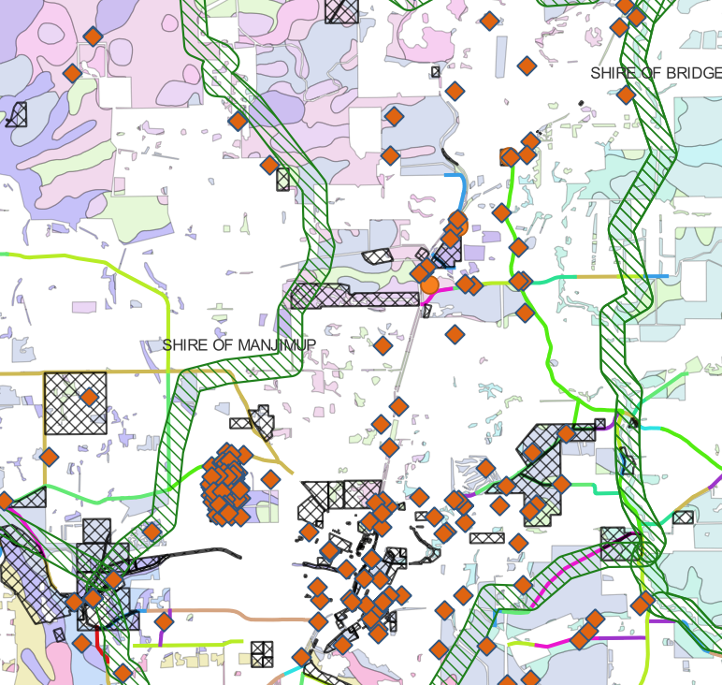
Natural Area Initial Desktop Assessment Template
Collate available site information
Vegetation type, site history, land use and land tenure
Identify similar sites that might act as reference sites
Identify similar sites that might act as reference sites
Refer to the list of relevant datasets
(Appendix 6 of the NAIA Template)
Complete before starting field assessments

Slide 14
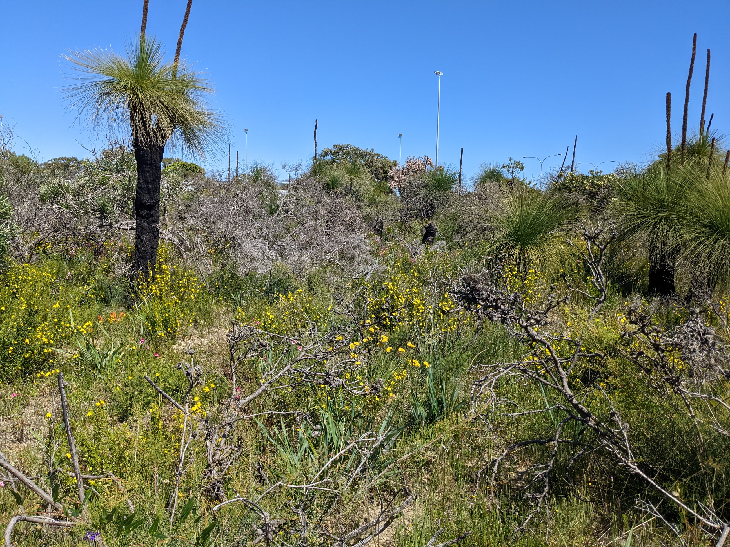
Natural Area Initial Field Assessment A Template
Familiarise yourself with the Template before going to the site – know what to look for
If a reference site is identified, visit the reference site
Identify similar sites that might act as reference sites
Remember, you are doing an initial assessment
When you arrive at a site, drive or walk (depending on size and access) around the whole site first, making rough sketches
~ 10x10m
Select point locations for assessments
For each identified structural plant community in the highest vegetation condition within a 10x10 metre area, record the description for each community on page 5 of the Templates
See Appendix 7: Percentage ground cover guide.

Slide 15
Field Assessment equipment checklist
Aerial photo (A4) – 2-3 copies
NAIA A Template with multiple copies of page 5
Background biological information, including a map
Clipboard, coloured permanent markers or coloured pencils, small ruler
Notebook
Flora licence (if needing to collect specimens for identification)
GPS
Camera/mobile phone
Backpack with first aid kit
Appropriate dress and water
Boot cleaning kit

Slide 16
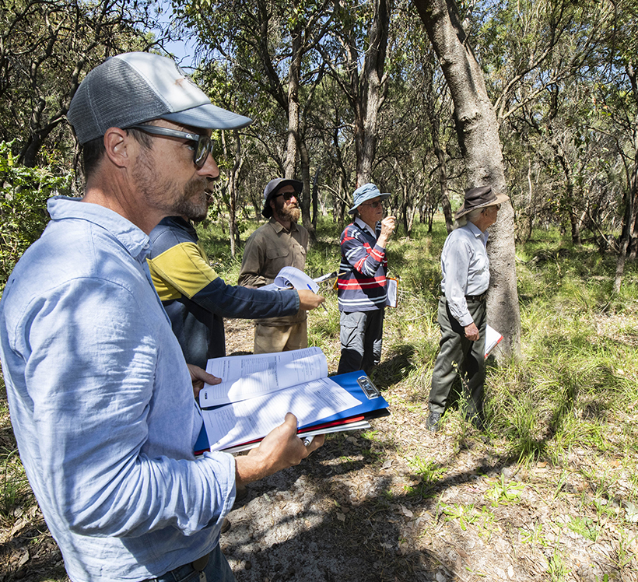
Natural Area Initial Field Assessment B Template
Record the presence of significant species or ecological communities
Requires a higher skill level to complete
See appendix 1 of NAIA Templates
Refer to guidance/forms from the Department of Biodiversity, Conservation and Attractions on compliance with Biodiversity Conservation Act 2016

Slide 17
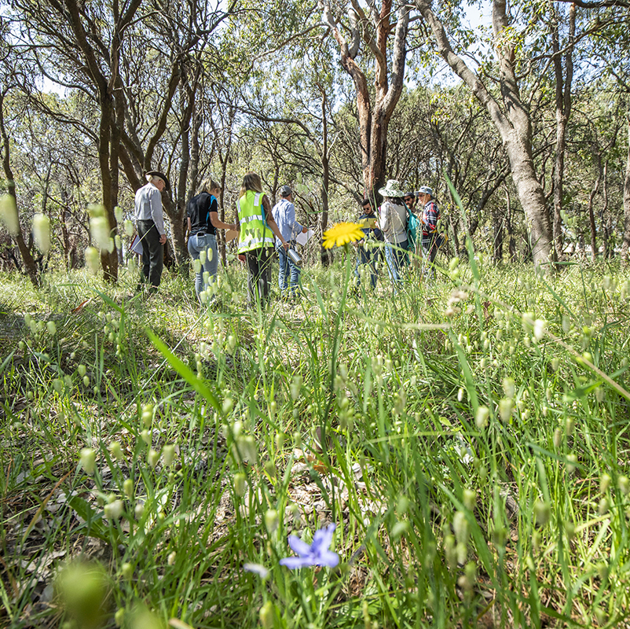
Natural Area Initial Assessment Summary Template
Combines desktop and field assessments
Consist of two parts:
1 Ecological criteria
2 Viability score
The criteria count is designed to highlight natural areas that meet the regional significance criteria and identify areas with multiple conservation considerations.

Slide 18
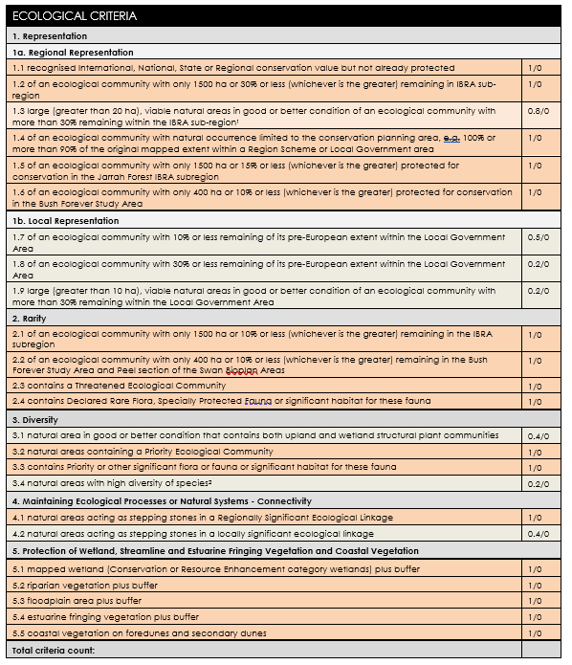
Ecological Criteria Count
Based on information captured via Desktop Assessment and Field Assessment A and B
Vegetation statistics
The latest published statistics of vegetation extent by vegetation type are available via www.data.wa.gov.au.
Use these to determine whether vegetation types at the site meet any of the criteria 1.2 - 1.9, 2.1 and 2.2.
A Local Biodiversity Strategy lists vegetation types and their regional and local levels of retention and protection.
Protected areas refer to those natural areas that are secured for conservation either as public lands vested for biodiversity conservation (e.g. Crown reserves vested for protection of flora and fauna) or private lands where natural areas are protected via zoning provisions or covenanting.

Slide 19
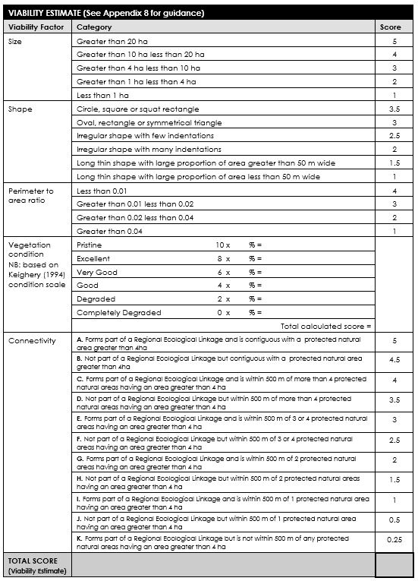
Viability Estimate
Viability is the likelihood of long-term survival of a particular ecosystem or species.
Follow instructions in Appendix 8 on how to estimate the viability score.
To save time, identify, list and display as a aping layer all protected natural areas over 4 hectares within the Local Government area in one exercise before you complete the individual site assessments.
Image: City of Bunbury, Amangu Country

Slide 20
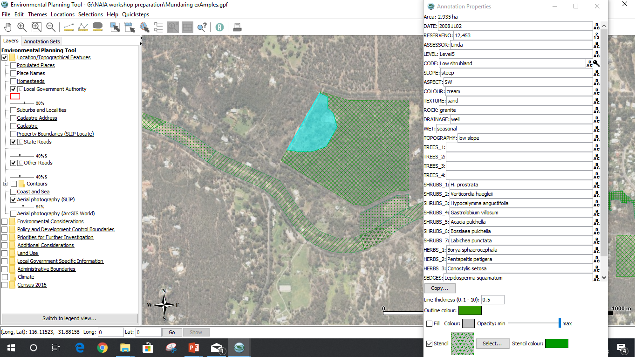
Use of NAIA data example
Intramaps Layer
Image: City of Joondalup reserve mapping (Source: City of Joondalup Online Intramaps,, January 2024)

Slide 21
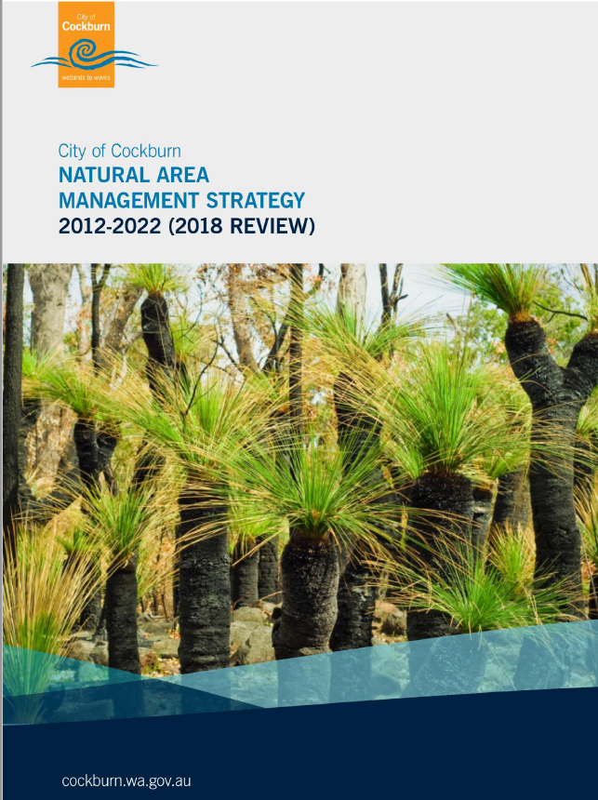
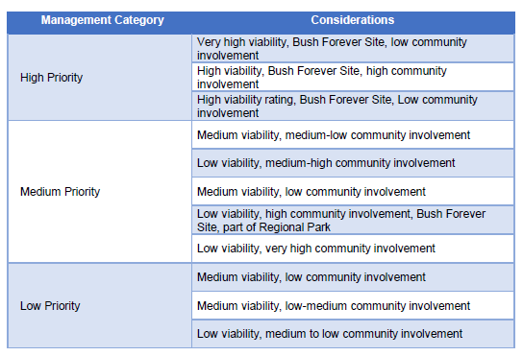
Use of NAIA data example
City has adapted NAIA template to include other categories:
Passive recreation
Education
Community
Have assigned numerical ranking to Ecological Criteria.
Source:
City of Cockburn website

Slide 22
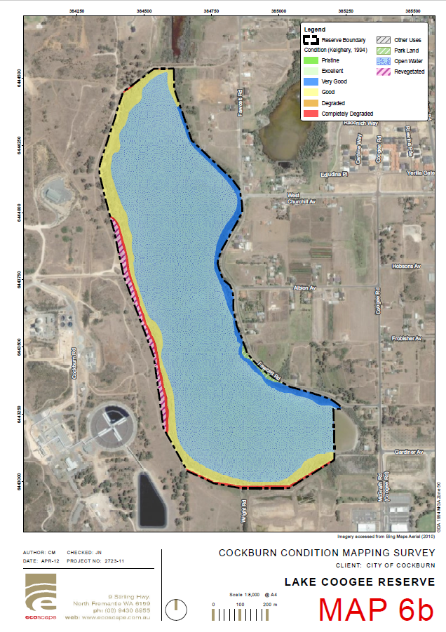
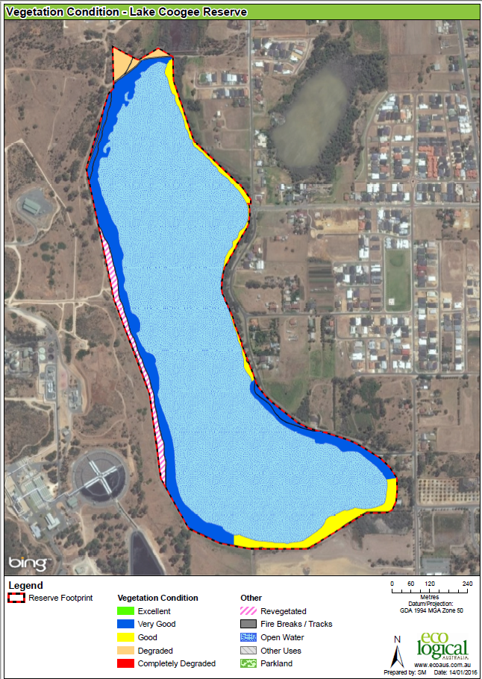
Use of NAIA data example
Monitoring effectiveness of management
Source: City of Cockburn

Slide 23
Executive Summary
Initial Assessment
Desktop Assessment
Field Assessments
Assessment Summary
Assessment to inform further management requirements, including the need for further detailed assessments
Complete prior field assessment
Confirm inferred values on site and record management issues
Use to prioritise assessed areas for conservation and management

Slide 24
Contact
To download the NAIA Templates and Appendices, visit the WALGA website.
For further information, email environment@walga.asn.au
Acknowledgements
Photo credits: Where not listed, WALGA
This project is supported by funding from the Western Australian Government’s State NRM Program

