Slide 1
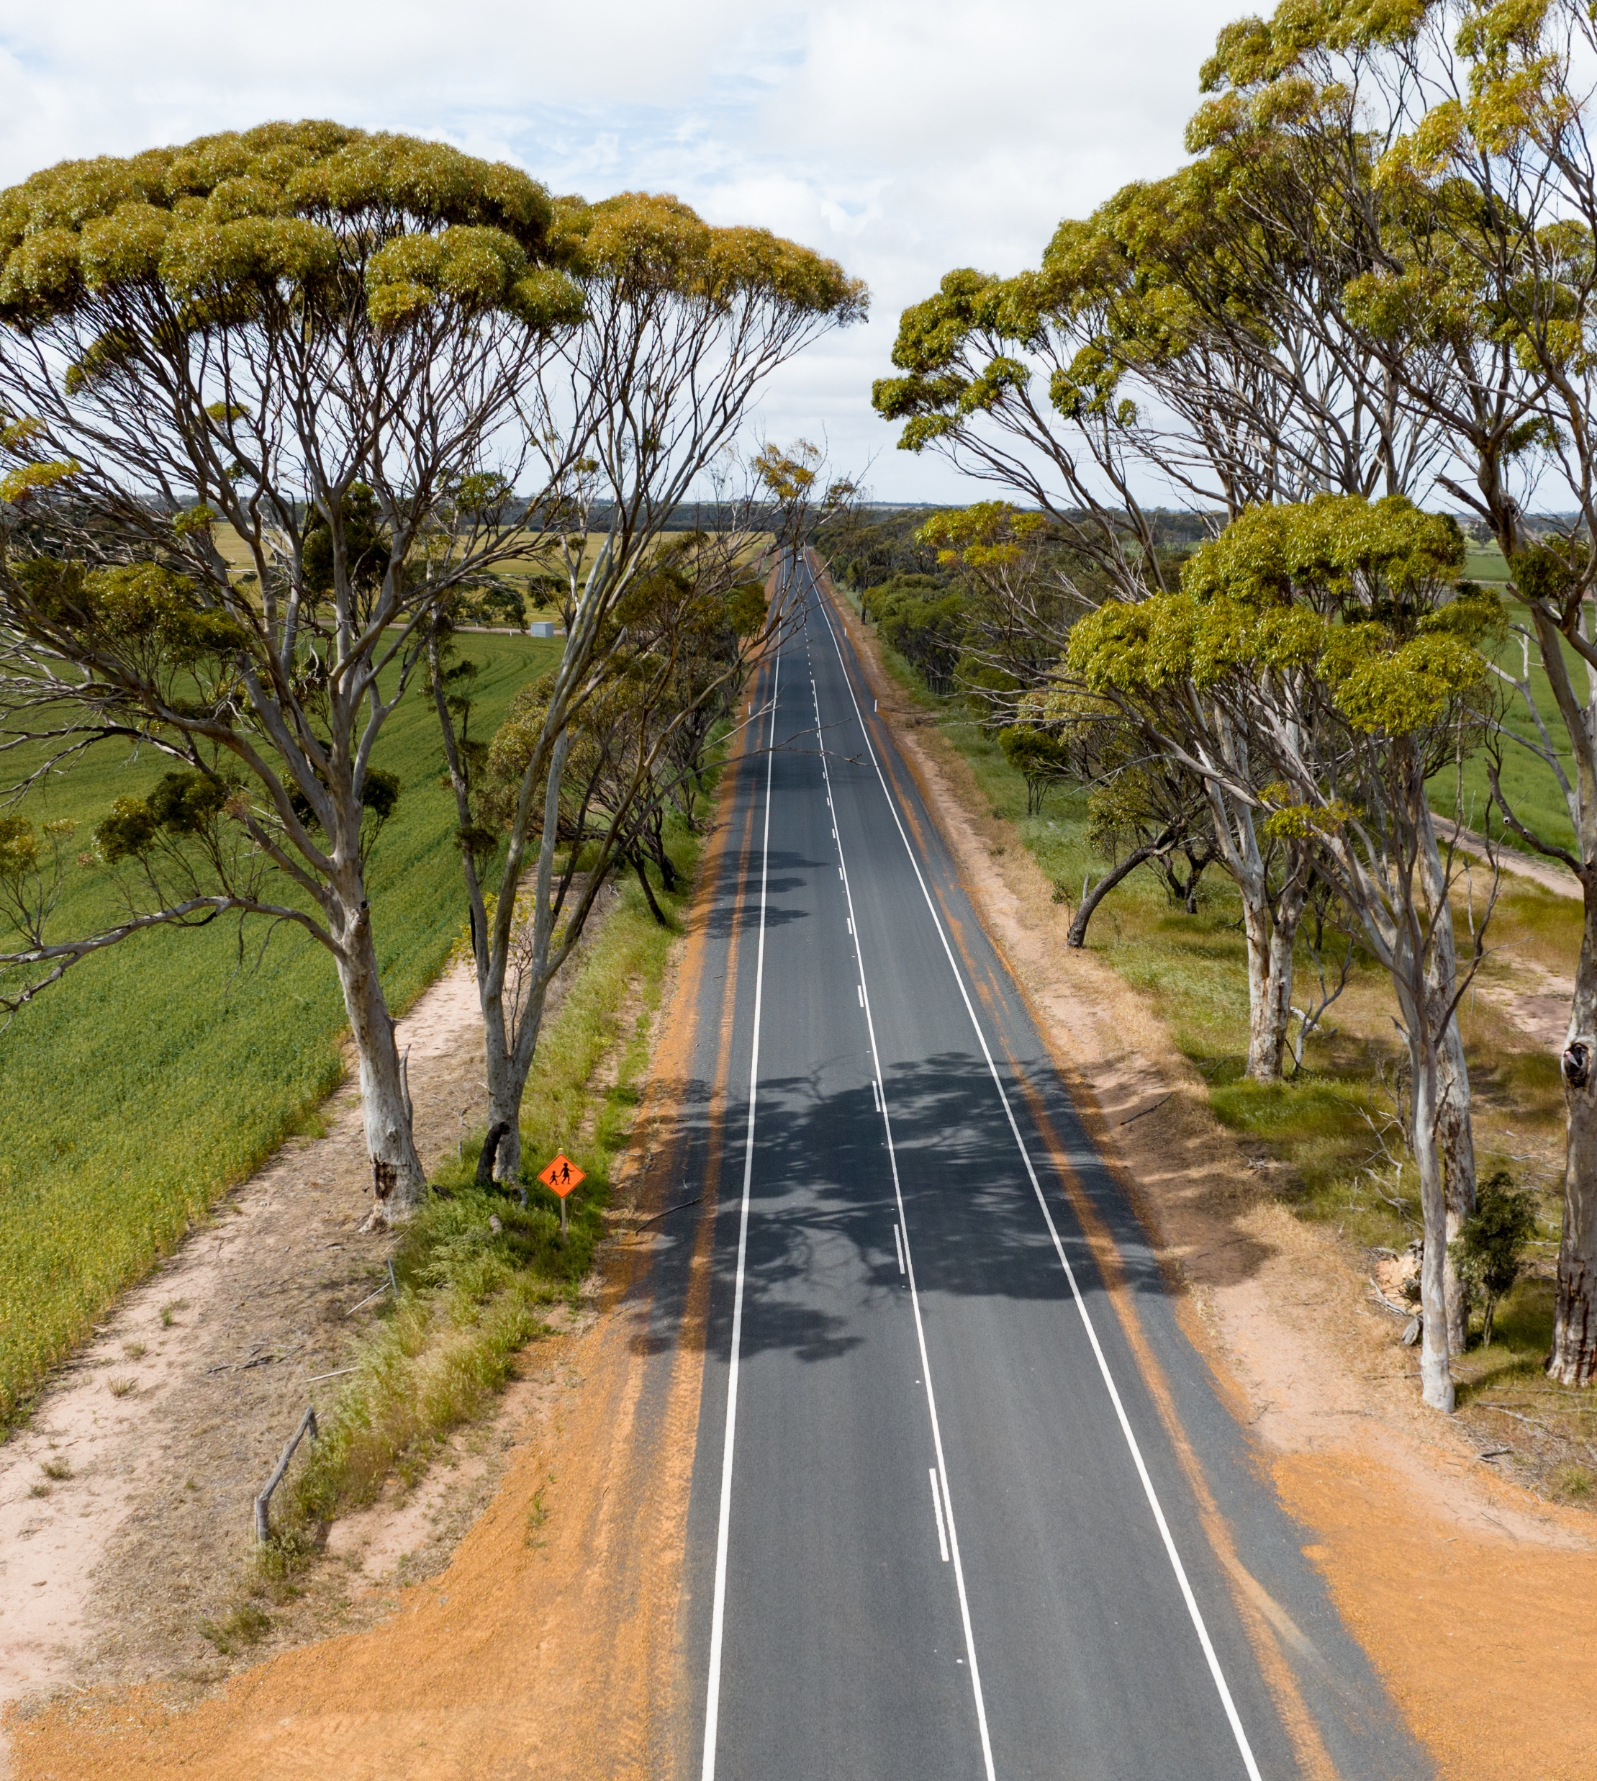
Roadside Vegetation
Management – Part 1
Guidance for Local Government
in Western Australia
2024

Slide 2
Acknowledgement of Traditional Owners
WALGA acknowledges the continuing connection of Aboriginal people to Country, culture and community. We embrace the vast Aboriginal cultural diversity throughout Western Australia, including Boorloo (Perth), on the land of the Whadjuk Noongar People, where WALGA is located and we acknowledge and pay respect to Elders past and present.
Pictured left: Artwork by Jade Dolman, a young Whadjuk/Ballardong Nyoongar, Eastern Arrernte, Irish woman from Perth.

Slide 3
3
Roadside vegetation management training module – Overview
Part 1: Road reserves and Local Government roles and responsibilities in roadside vegetation management
Part 2: Meeting the regulatory requirements for road works affecting roadside vegetation
Part 3: Delivering works in road reserves
Preparation of this resource was supported by funding from
the Western Australian Government’s’ State NRM Program
Photo: WALGA

Slide 4
4
Part 1 Overview
Why is there vegetation in road reserves?
Regulatory requirements applicable to activities affecting roadside vegetation
Local Government roles and responsibilities
Photo: WALGA

Slide 5
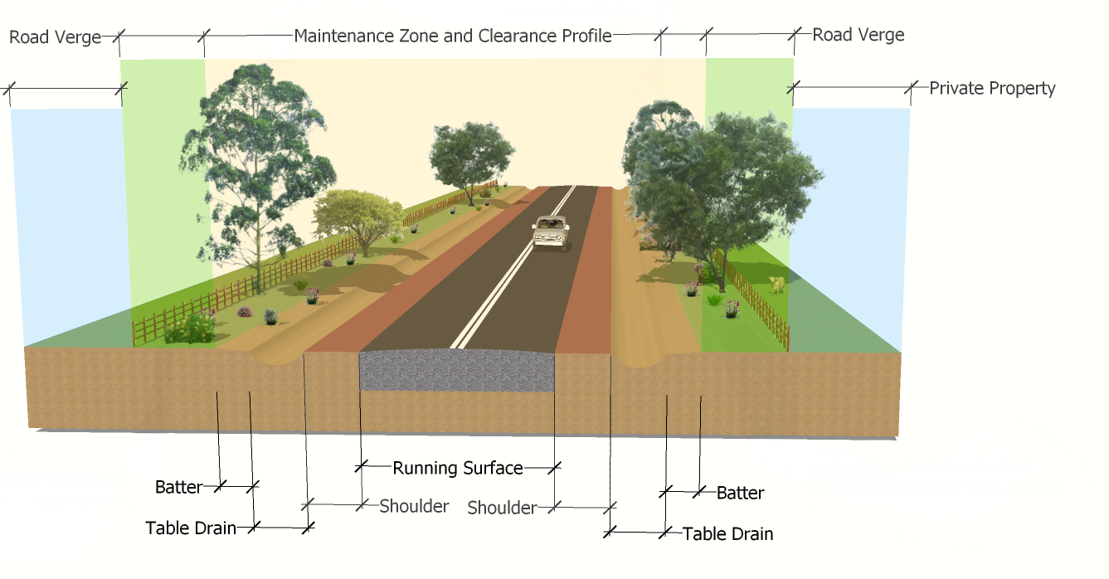
Road reserve zones
Verge treatment zones |  |  | Treatment Objectives
Frangible vegetation zone | Vegetation zone | Boundary zone
 |  |  | Vehicle recovery
 |  |  | Clearance for utilities
 |  |  | Remove hazard
 |  |  | Prevent erosion
 |  |  | Control fires
 |  |  | Control weeds
 |  |  | Preserve heritage values
 |  |  | Maintain & Enhance visual amenity
 |  |  | Conserve biodiversity
20-100 meters
Source: Revegetation & Landscaping Guideline (Main Roads WA, 2015)

Slide 6
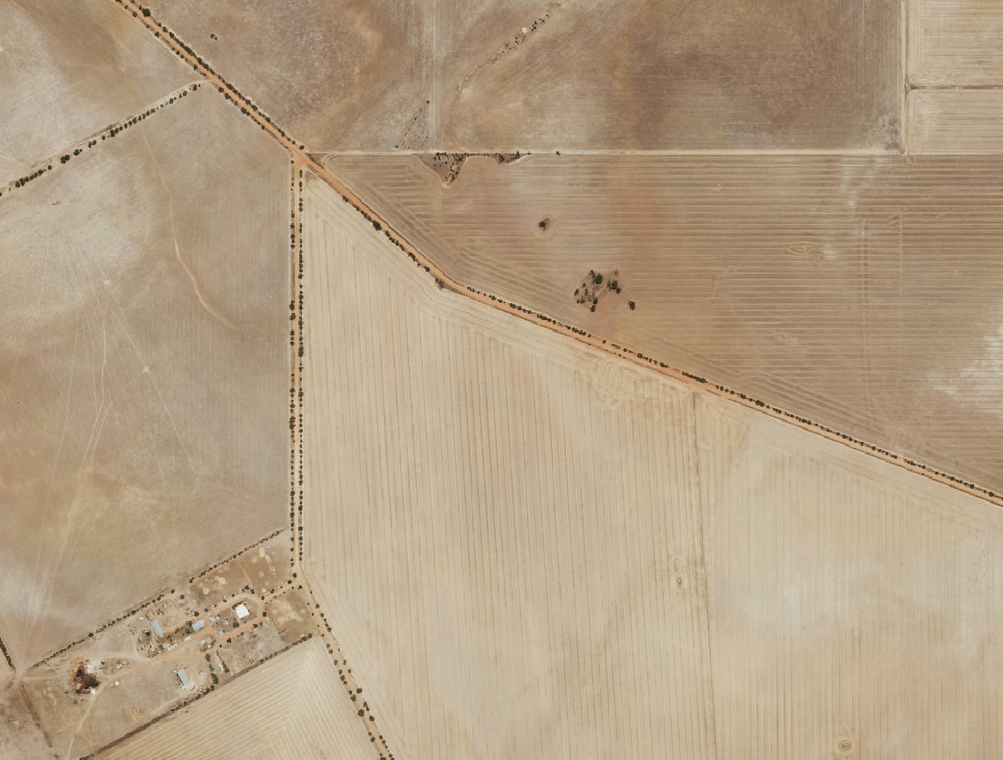
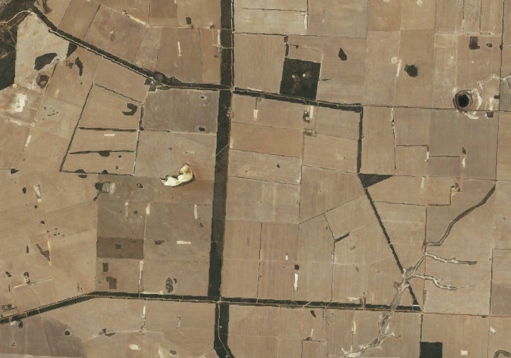
Why is vegetation in road reserves?
That is where vegetation was not cleared for farming OR
Road reserves designated in accordance with Government policy
“So great has been the desire of the settler to conquer the forest and produce crops that far too little timber has been left for the purposes of shade, shelter and firewood.”
By G.L Sutton, Director of Agriculture (From A Story of a Hundred Years (1929), WA’s official Centenary Book)
“The present Government has a policy of providing in all new subdivisions in agricultural lands at least 20% for reserves…It has been found that the road width of less than 3 chains would not give the necessary area for services such as the formation of roads, drainage and the protection of the natural fauna.”
Minister for Lands to the Country Shire Council’s Association, 1965
Notes:
Road reserve designation happened in two stages in WA. Before mid 50-ies, 20m wide road reserves were a standard.
Replace image with aerials

Slide 7
Why is native vegetation in road reserves?
Staged road reserve designation in new land releases in Western Australia
Pre 1952
1952-1964
1965-1979
Standard road width - 20 m
To provide for the passage of people and goods
In 1929, concerns raised at over-clearing
Growing community interest in wildflower tourism
Growing understanding of the high levels of diversity of vegetation across the SW WA
Government decision to add a half chain on each side of specified main roads to retain vegetation, primarily on light sands - 40 m, later increased to a minimum of 60m, with some being 100 and 200 m
From 1959, landholders in new farmland releases were directed not to trespass into road reserves to prevent vegetation loss
In 1962, Surveyor General requests the Government to adopt a minimum road width of 100 m and to investigate widening of existing road reserves to facilitate the preservation of wildflowers
In planning new subdivisions, the Minister for Lands (on request of the Premier) directs the creation of flora reserves by setting a minimum road width at 60 m, in some areas 100 m to 200 m.
The adopted policy was for new country roads to be of sufficient width to facilitate the road, drainage and the protection of flora.
Evidence of feeding by the threatened Carnaby’s black cockatoos on vegetation in a local road reserve. . Photo: WALGA
Notes:
Road reserve designation happened in two stages in WA. Before mid 50-ies, 20m wide road reserves were a standard.
Replace image with aerials

Slide 8
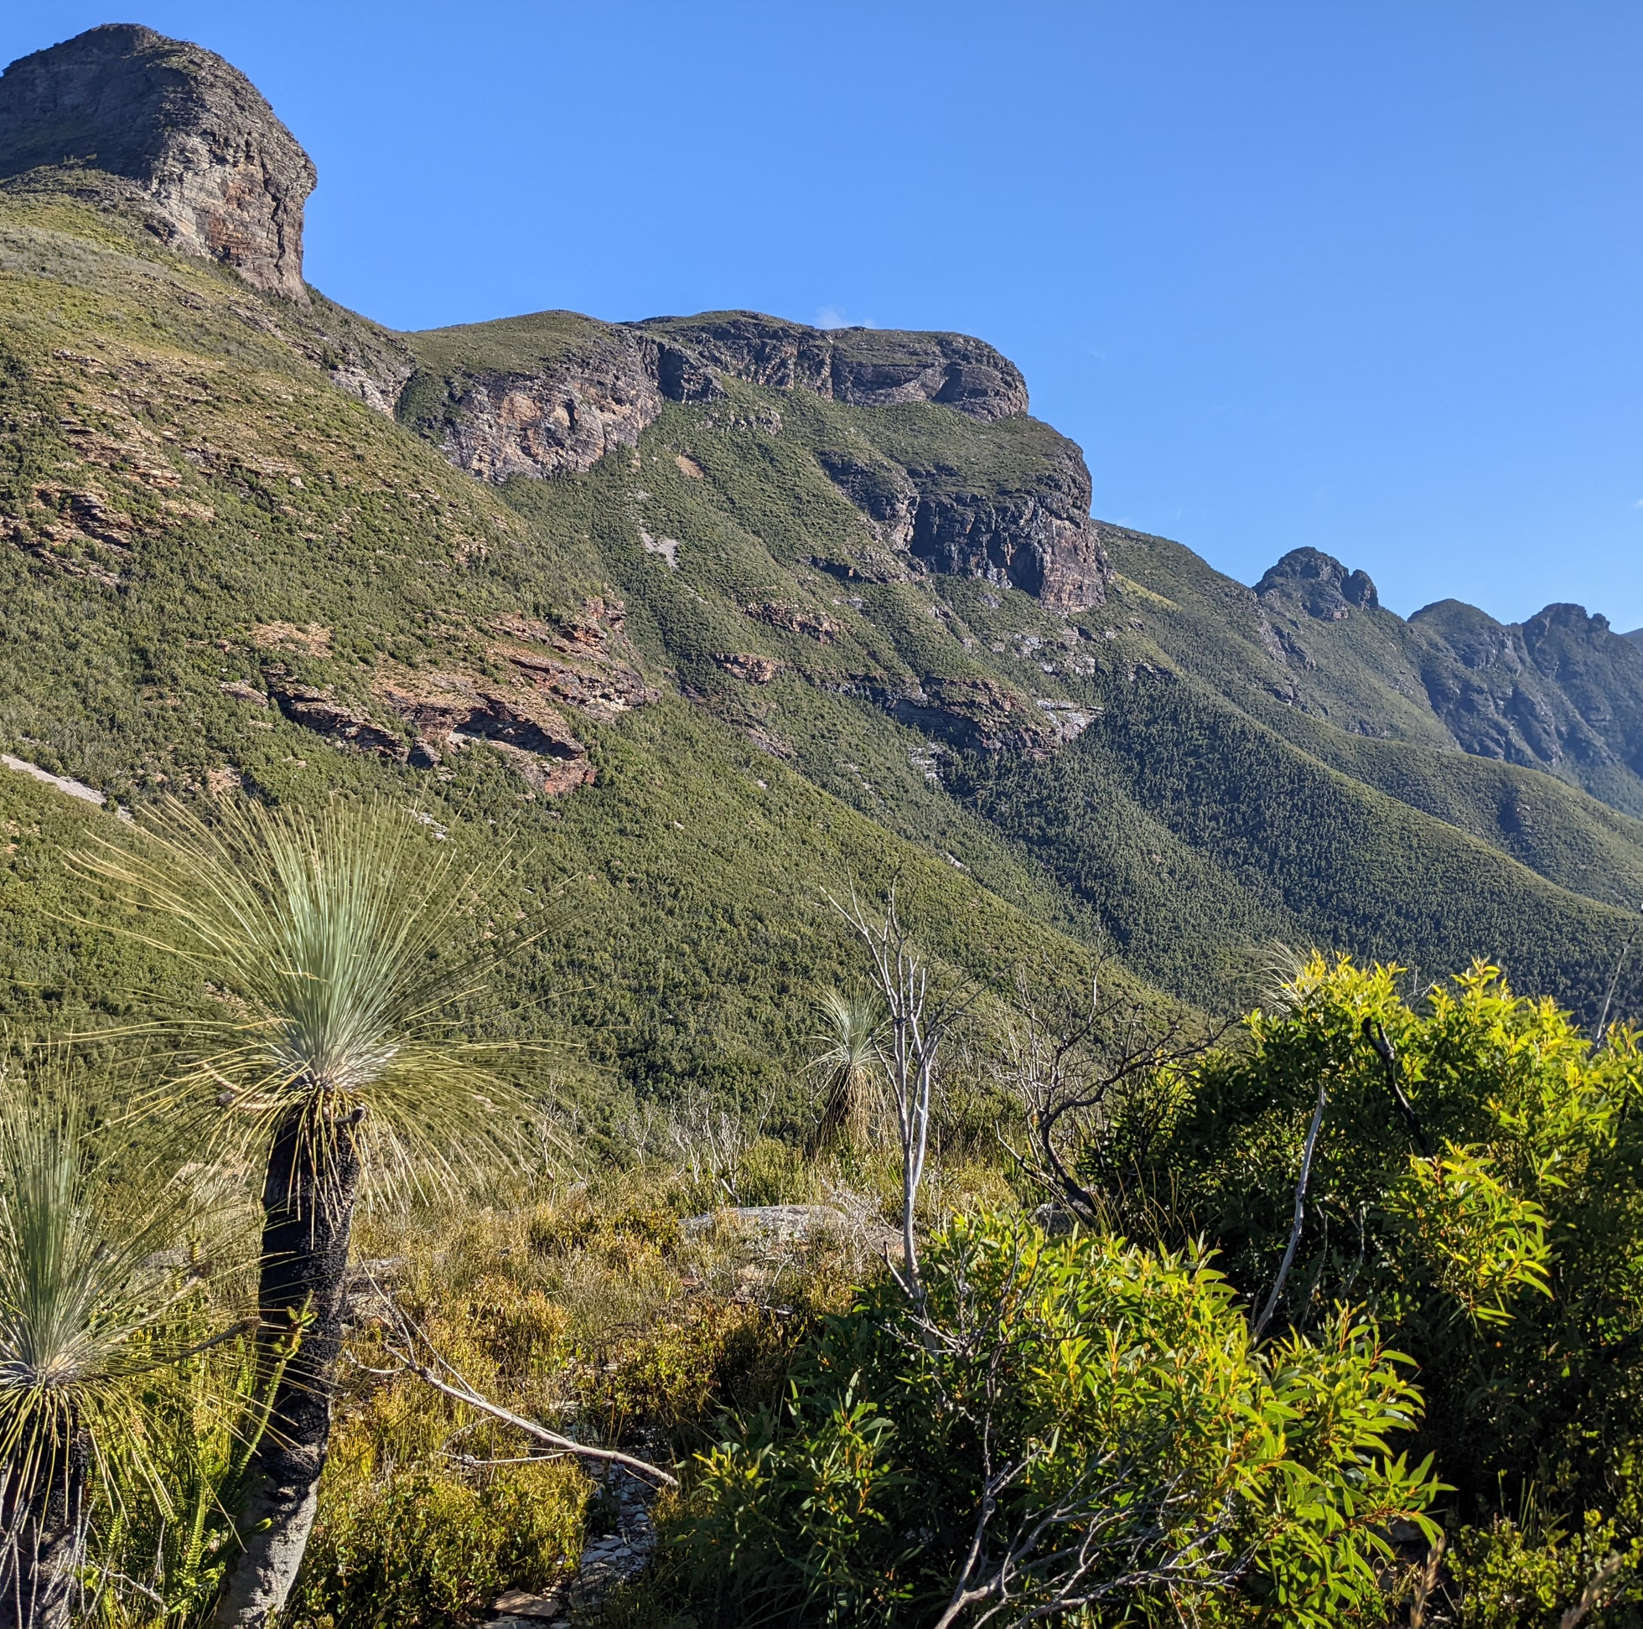
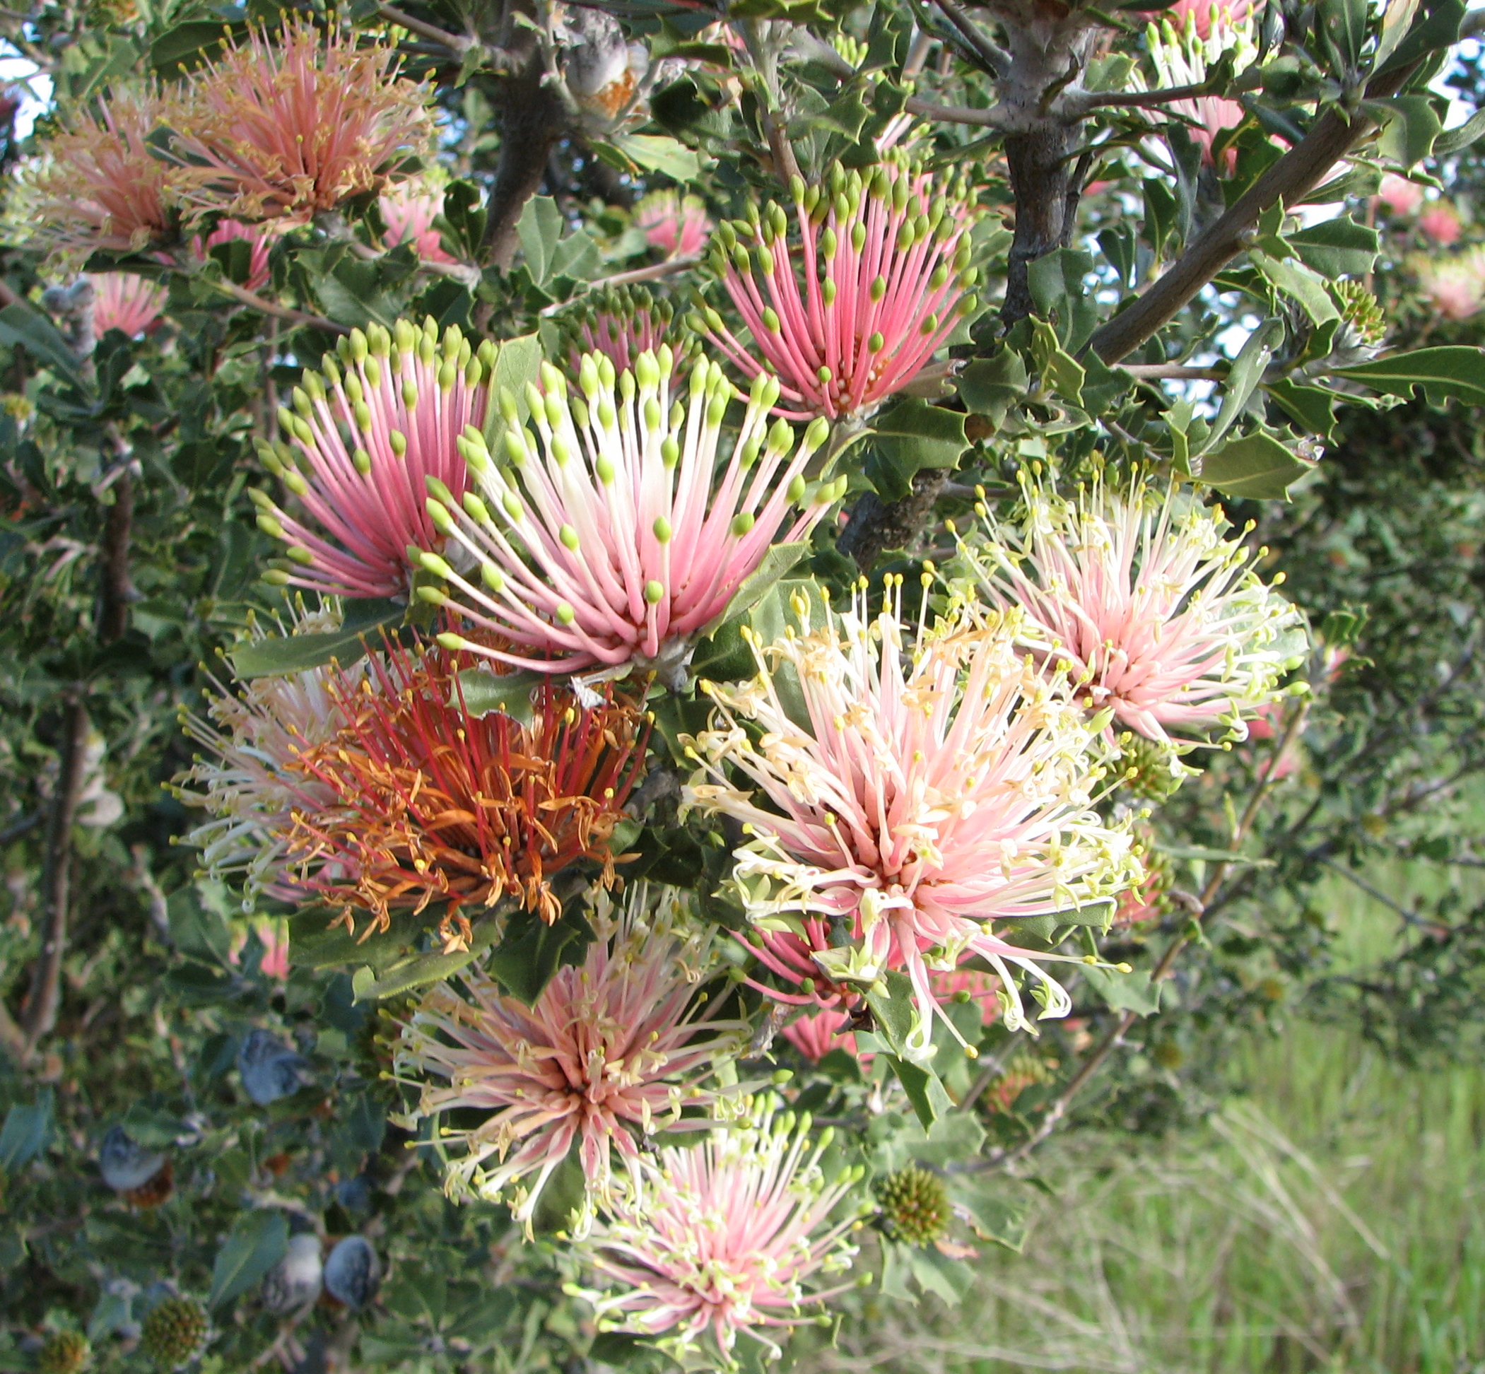
8
Characteristics of Western Australian vegetation
High species richness
High degrees of endemism
Large portion pollinated by animals
Vulnerable to varied threatening processes
High species richness – over 11,000 species of plants recorded in WA – more than half of Australia’s flora
New species are still being discovered
60% of plants recorded in WA are not found anywhere else
Many occur in small localised populations
15% of plants pollinated by birds and mammals – the highest incidence of this dependence on Earth
Fragmentation due to historical indiscriminate land clearing
Changed fire regimes
Diseases – 40% of plants susceptible to Phytophthora dieback

Slide 9
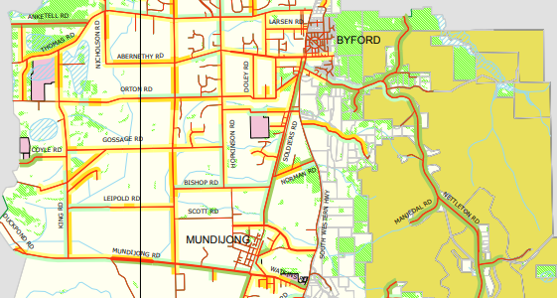
Local Government managed road reserves
In Western Australia, Local Governments manage over 87% of road reserves
Of the roadside vegetation assessed for ecological values between 1987 and 2015, covering 58 Local Governments in the SW of WA, 40% of assessed roadsides were determined to be of high conservation value and 24% of medium to high value
Example of roadside conservation value mapping: Shire of Serpentine-Jarrahdale, Prepared by the Roadside Conservation Committee, 2006

Slide 10
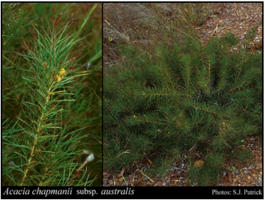
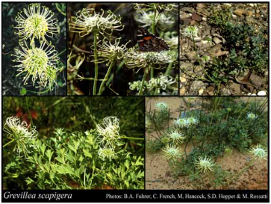
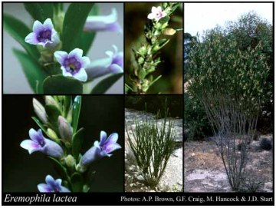
Conservation values of road reserves
Retain diverse range of vegetation types representative of the local landscape, including last examples of original vegetation types, threatened ecological communities and threatened plants.
Examples of threatened plants with all or all but one known occurrences being in local roadsides (Images sourced from Florabase).
Endangered
Found only in the Shires of Toodyay and Victoria Plains
Endangered
Found only in the Shire of Corrigin
Endangered
Found only in the Shire of Esperance

Slide 11
Evidence of feeding by the threatened Carnaby’s black cockatoos on vegetation in a local road reserve. . Photo: WALGA
Conservation values of roadside vegetation
Provide foraging and breeding habitat for wildlife, including habitat for threatened species, pollinators and insectivorous birds.
Examples of threatened wildlife utilizing roadside vegetation:
Mallee fowls have been recorded nesting in road reserves with good quality vegetation
Carnaby’s and Forest red-tail black cockatoos forage on vegetation in road reserves
Notes:
Due to the high levels of historical clearing in large parts of the SW of WA, in many areas vegetation in road reserves retains the last examples of original vegetation, habitat for local wildlife.

Slide 12
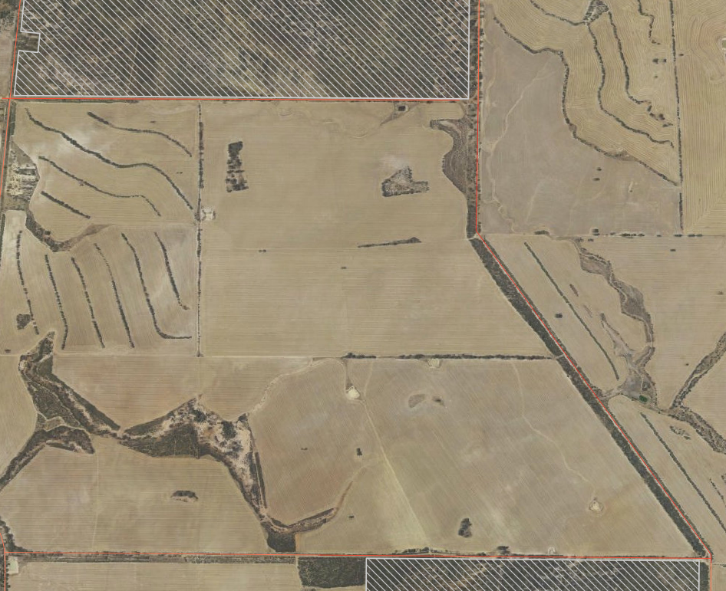
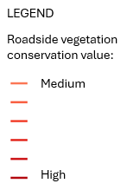
Conservation values of roadside vegetation
Enable the movement of animals and plant material between remaining patches of vegetation
Prevention of soil erosion
Reducing the risk of soil degradation from secondary salinity
In the Kellerberrin region, where only 9% of original vegetation remains, western yellow robin and blue-breasted wrens, two uncommon species in the Wheatbelt, were recorded nesting in road reserves with well-developed shrub understorey.
Lynch & Sanders, 1991)
Notes:
Due to the high levels of historical clearing in large parts of the SW of WA, in many areas vegetation in road reserves retains the last examples of original vegetation, habitat for local wildlife.

Slide 13
Other values of roadside vegetation
Windbreaks
Shelter for stock animals
Sense of place – local identity
Cultural values
Scenic values of tourist destinations, including wildflower drives
Evidence of feeding by the threatened Carnaby’s black cockatoos on vegetation in a local road reserve. . Photo: WALGA

Slide 15
Legislation
State Government
Biodiversity Conservation Act 2016
Biodiversity Conservation Regulations 2018
Environmental Protection Act 1986:
Environmental Protection (Clearing of Native Vegetation) Regulations 2004
Environmental Protection (Environmentally Sensitive Areas) Notice 2005 (ESA Notice)
Australian Government
Environmental Protection and Biodiversity Conservation Act 1999
Matters of National Environmental Significance (MNES) – See the online MNES search tool
Eucalyptus woodlands of the Wheatbelt Region of WA, nationally listed threatened ecological community. Scan this QR Code to access the Wheatbelt Woodlands Survey Tool.
Instructions on how to use this tool can be downloaded from https://www.wheatbeltnrm.org.au/sites/default/files/Poster - Healthy Environments - WWTA - Flyer TEC Tool.pdf
Photo: Courtesy of Wheatbelt NRM.

Slide 16
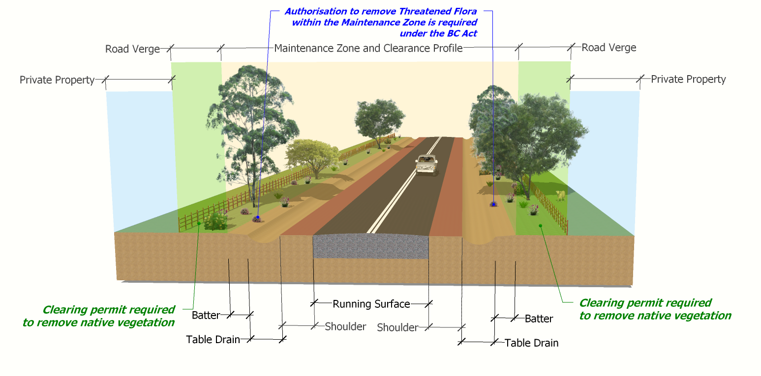
Check for Matters of National Environmental Significance (EPBC Act )
Where clearing permit granted, no further authorisation is needed under BC Act
Where clearing permit granted, no further authorisation is needed under BC Act
Clearing in Maintenance Zone exempt by prescription in Regulation 5, Item 22 & Schedule 2 of the EP Act: Clearing in existing transport corridors.
But authorisation to remove Threatened Flora within the Maintenance Zone if required under the BC Act

Slide 17
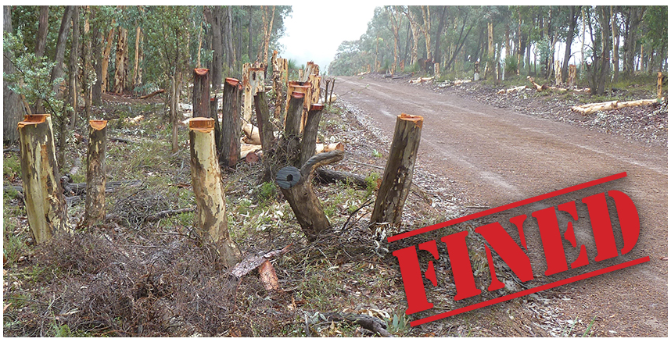
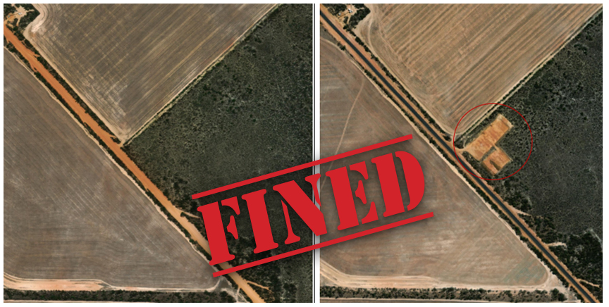
Risk of non-compliance with legislative requirements
To avoid reputational damage, prosecution and cost to ratepayers:
Understand the current provisions of legislation
Adopt best practice procedures, checklists and Code of Conduct
Undertake relevant training
Keep records to demonstrate compliance and support decision making
Examples of unauthorised clearing by two Local Governments that were fined in 2024. Images reprinted from media releases with permission from the Department of Water and Environment Regulation.

Slide 18
Summary
Roadside vegetation has multiple functions and benefits
Local Government roles and responsibilities in roadside vegetation management includes:
Asset management
Project delivery
Facilitator of land access
Impacts on vegetation in road reserves are regulated via two State Acts and the Australian Government legislation, the Environmental Protection and Biodiversity Conservation Act 1999
Photo: WALGA

Slide 19
Disclaimer
At WALGA, we've made every effort to ensure that the material contained on our website is accurate, current and reliable at the time it was created or last modified.
While the material on this resource is compiled with due care, WALGA does not warrant or accept liability with regards to the accuracy or completeness of the material. As such, no reliance should be made by the user on the material who should carefully assess the relevance and accuracy of that material, including seeking confirmation from the originating body.
The information delivered to you via any externally hosted website is produced and managed by the website owner. All care has been taken to ensure validity of these external sites, however WALGA cannot be held responsible for any misrepresentation of information found on any external websites.
If you wish to clarify anything about this site or have concerns regarding your privacy, please contact us.
Copyright
All material that appears in this presentation, including content, graphics and audio is protected by the operation of the Copyright Act 1968, and is owned by the WALGA unless otherwise referenced as being from another source. Materials contained here can be reproduced for personal and non-commercial use, without permission providing it remains unaltered in its original form. Should you wish to reproduce material that is for commercial or non-personal use, you can request permission to do so by contacting us.
Contact
For further information email to environment@walga.asn.au
Resources
To download resources supporting roadside vegetation management visit WALGA’s website
To download mapping data, go to
Western Australian Local Government Association - Organisations - data.wa.gov.au
This Project is supported by funding from the Western Australian Government’s State NRM Program

