Slide 1
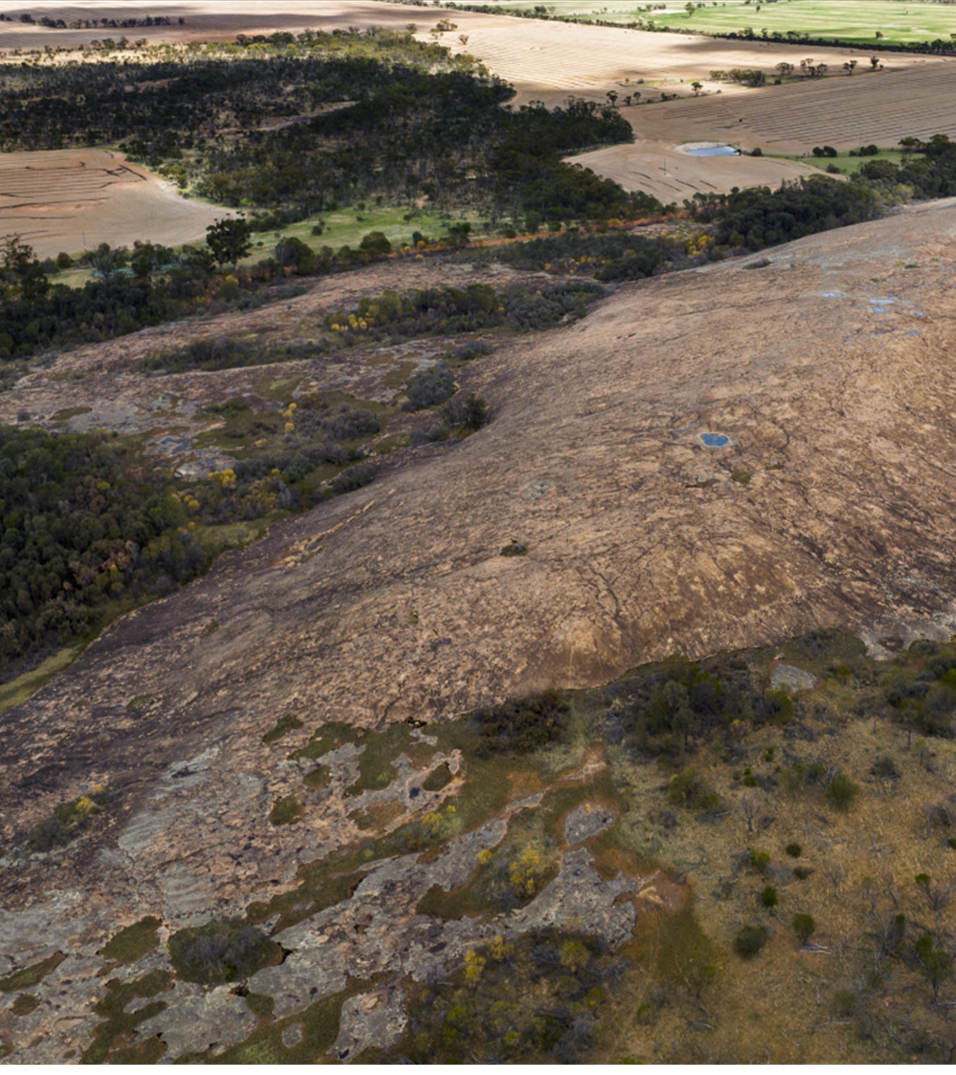



An Introduction to
Local Biodiversity
Planning for
Local Government
in the South-West of Western Australia

Slide 2

Acknowledgement of Traditional Owners
WALGA acknowledges the continuing connection of Aboriginal people to Country, culture and community. We embrace the vast Aboriginal cultural diversity throughout Western Australia, including Boorloo (Perth), on the land of the Whadjuk Noongar People, where WALGA is located and we acknowledge and pay respect to Elders past and present.
Pictured left: Artwork by Jade Dolman, a young Whadjuk/Ballardong Nyoongar, Eastern Arrernte, Irish woman from Perth.

Slide 3
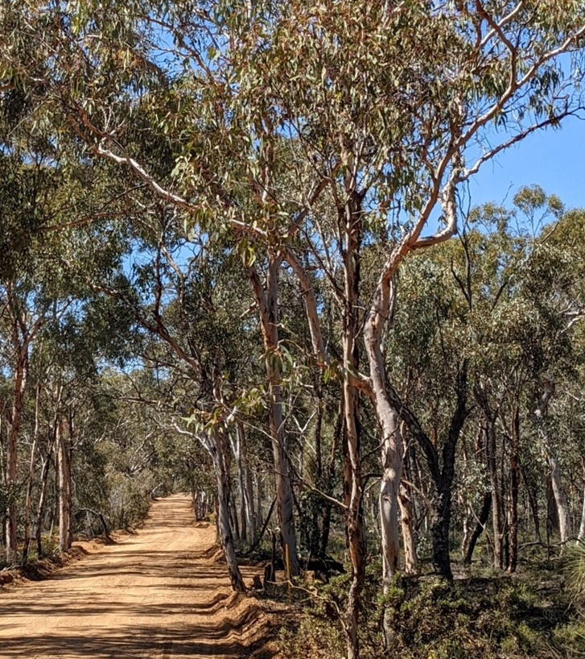





3
Overview
Local Governments and biodiversity
Support for local biodiversity planning
Components of an effective Local Biodiversity Strategy
What can Local Government influence?
Benefits of local biodiversity planning
Photo: WALGA

Slide 4
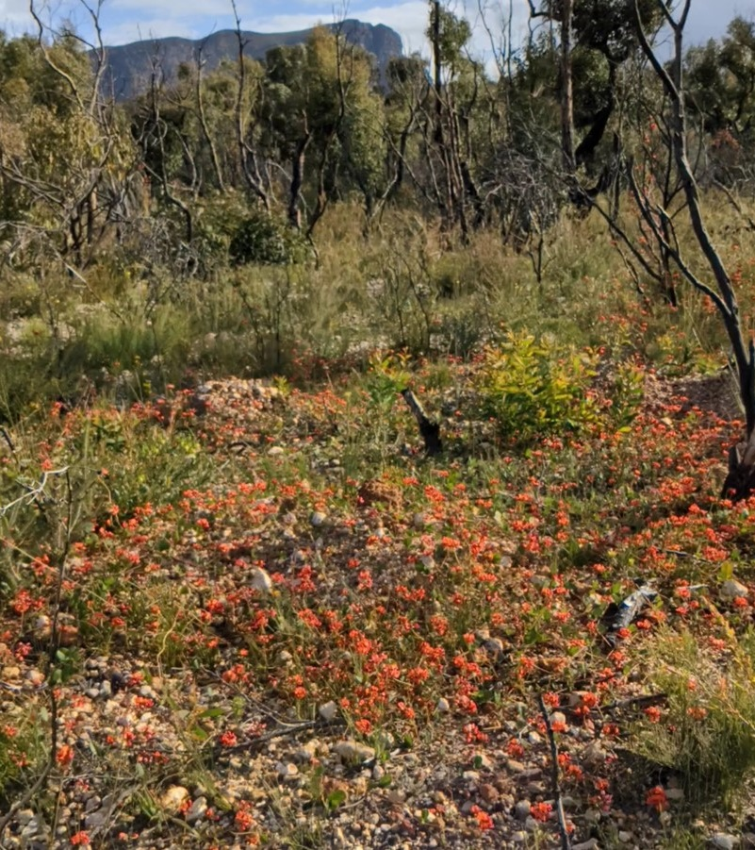
Biodiversity means the variability among living organisms and the ecosystems of which those organisms are a part and includes the following:
(a) diversity within native species and between native species
(b) diversity of ecosystems
(c) diversity of other biodiversity components.
Endemic refers to a species having a natural distribution confined to a particular geographic region.
Spring at the foothills of Stirling Ranges. Photo: WALGA

Slide 5
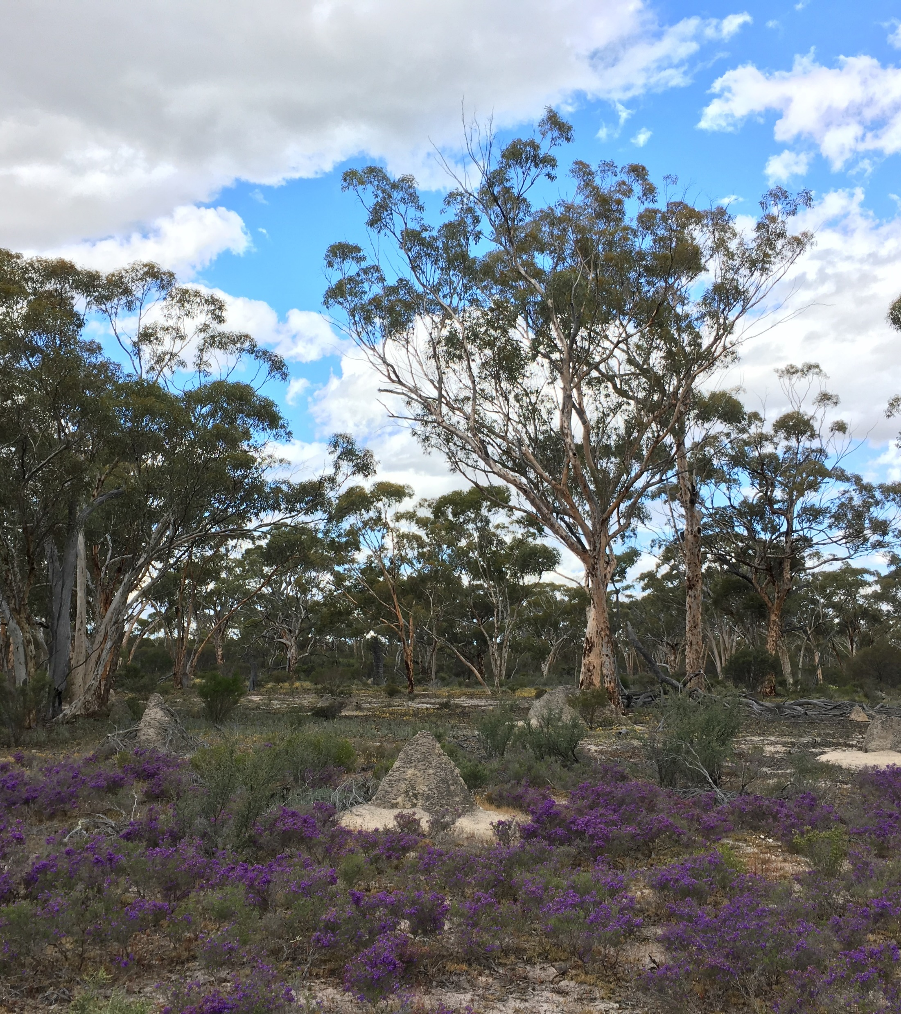
Legislation
Australian Government
Environmental Protection and Biodiversity Conservation Act 1999
  Matters of National Environmental Significance (MNES) – See the online MNES search tool
Nature Repair Act 2023
State Government
Biodiversity Conservation Act 2016
  Biodiversity Conservation Regulations 2018
Environmental Protection Act 1986
  Environmental Protection (Clearing of Native Vegetation) Regulations 2004
Eucalyptus woodlands of the Wheatbelt Region of WA, nationally listed threatened ecological community. Photo: Courtesy of Wheatbelt NRM.

Slide 6






Local Governments and Biodiversity
6
Australian and State Environmental Legislation
Regulator
Proponent
Assets manager
Facilitator
Administrator of local planning schemes: Land use planning provisions and Development approvals
Enforcement of Local Laws
Planner and manager of infrastructure projects
Natural areas in reserves and freehold land managed by Local Government
Native vegetation and habitat in parks and roadsides
Community education and engagement
Volunteer support
Landholder incentives

Slide 7
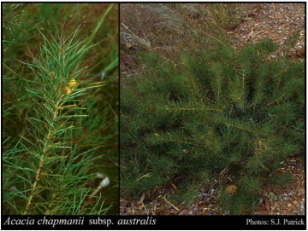
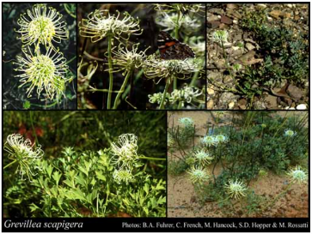
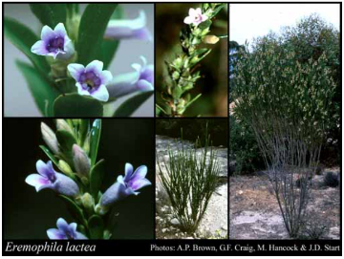
Local Governments and Biodiversity
In the Southwest of WA, Local Governments can affect nearly one third of mapped native vegetation through land use planning decisions and land management.
Some vegetation types are unique to a single Local Government area, and many are not protected via the State’s conservation reserve network.
Some of the State’s unique plants have been recorded only on Local Government managed lands; like below examples of threatened plants with all or all but one known location being in local roadsides (Images sourced from Florabase).
Endangered
Found only in the Shires of Toodyay and Victoria Plains
Endangered
Found only in the Shire of Corrigin
Endangered
Found only in the Shire of Esperance

Slide 8
Local Biodiversity Strategies and State Government processes
Land use planning
Recognition of local biodiversity conservation objectives is achieved when the WAPC endorses a local planning strategy which includes objectives for local biodiversity which are based on a local biodiversity strategy prepared:
in accordance with the endorsed methodology
in consultation with relevant stakeholders
endorsed by the Council.
Native vegetation clearing regulations (under Part V, Environmental Protection Act 1986)
Local Biodiversity Strategies can be a consideration in the assessment of clearing permit applications.

Slide 9
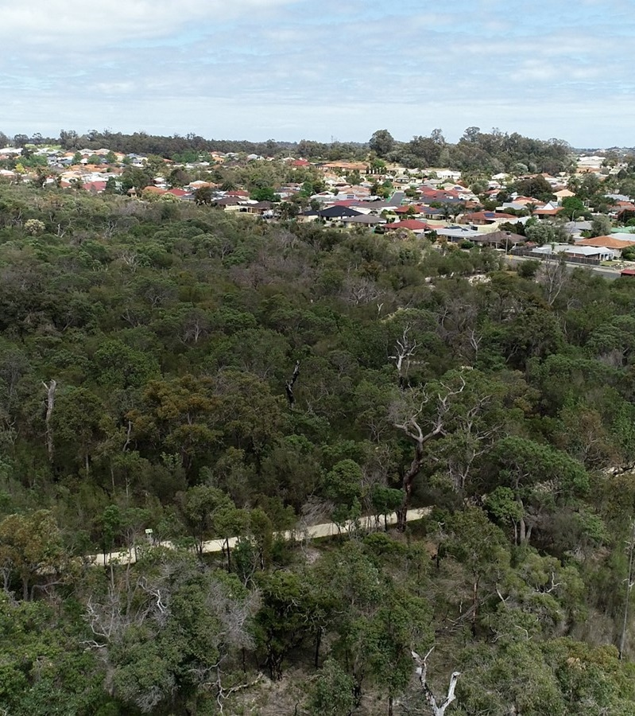
What is a Local Biodiversity Strategy?
A Local Biodiversity Strategy provides for:
the identification of local natural areas, the biodiversity they support and their conservation significance/priority
the assessment of local opportunities and the constraints to protection of local natural areas
the identification of ways to achieve local biodiversity conservation objectives and targets.
Photo: WALGA

Slide 10
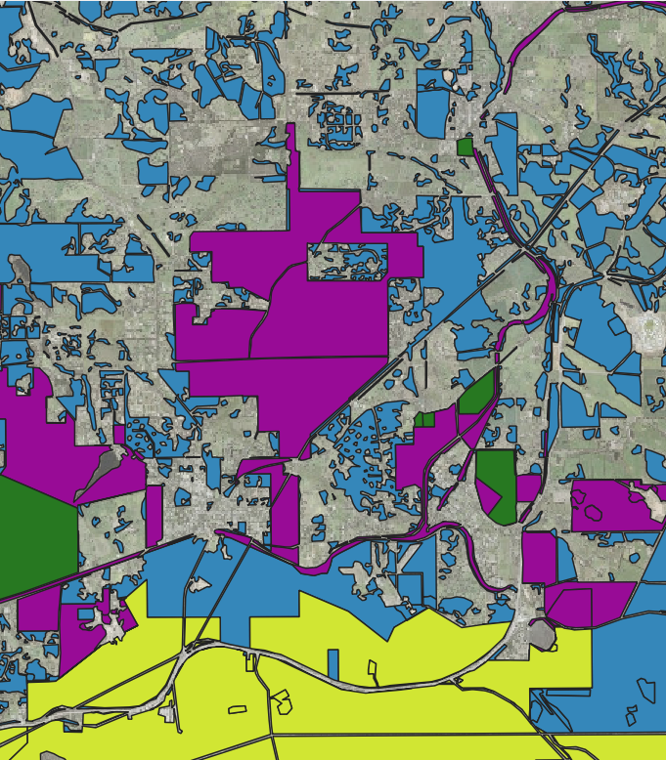
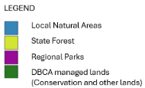
Key features of an effective Local Biodiversity Strategy
Focus on ‘Local Natural Areas’ including biodiversity on public and private lands
Objectives and targets are based on spatial analysis, consistent endorsed prioritisation criteria and considered in the regional context
Include a bushland protection map and/or local conservation priorities maps
An action plan that integrates biodiversity consideration into all areas of Local Government functions
Prepared in consultation with relevant stakeholders and endorsed by the Council.
2020 vegetation extent by administrative planning categories. Download dataset via DataWA @ Western Australian Local Government Association - Organisations - data.wa.gov.au

Slide 11
Local Biodiversity Planning Principles
Species diversity
Retention of at least 30% of the pre-European extent of each ecological community is required to prevent an exponential loss of species
Protect regionally and locally significant natural areas
Conserve biodiversity in-situ, protect what remains before revegetating
Regeneration is a higher priority than revegetation.
Biodiversity loss in relation to native vegetation loss (Smith & Siversten 2001)

Slide 12
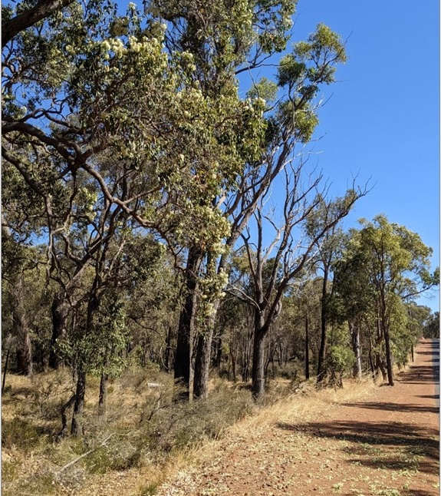
Local Biodiversity Planning Principles
Prioritise protection and management of the highest biodiversity value natural areas
Support community involvement in biodiversity conservation
Biodiversity values must be made transparent in decision-making
Site specific field survey is essential to understand biodiversity value
Natural area conservation is a legitimate land use.
Evidence of feeding by the threatened Carnaby’s black cockatoos on vegetation in a local road reserve. . Photo: WALGA

Slide 13
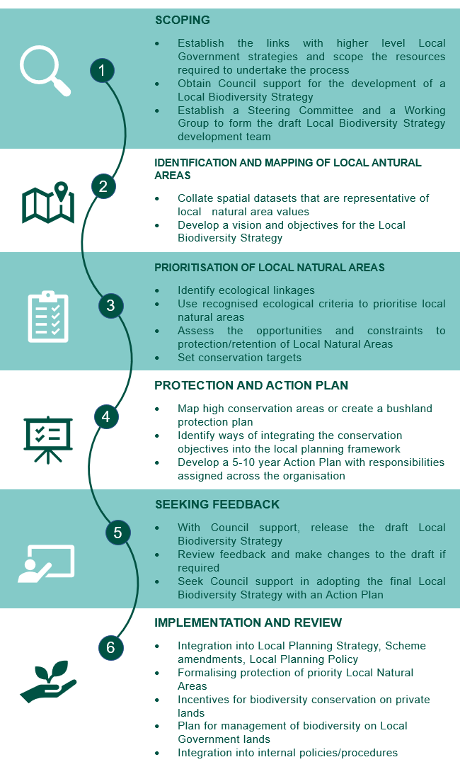
2 months after securing resources
Local Biodiversity Planning Phases
1 month
2 months
Scoping
Identification and Mapping of Local Natural areas
Prioritisation of Local Natural Areas
Protection and Action Plan
Seeking Feedback
Implementation and Review
3 months
2-3 months
5-10 years

Slide 14
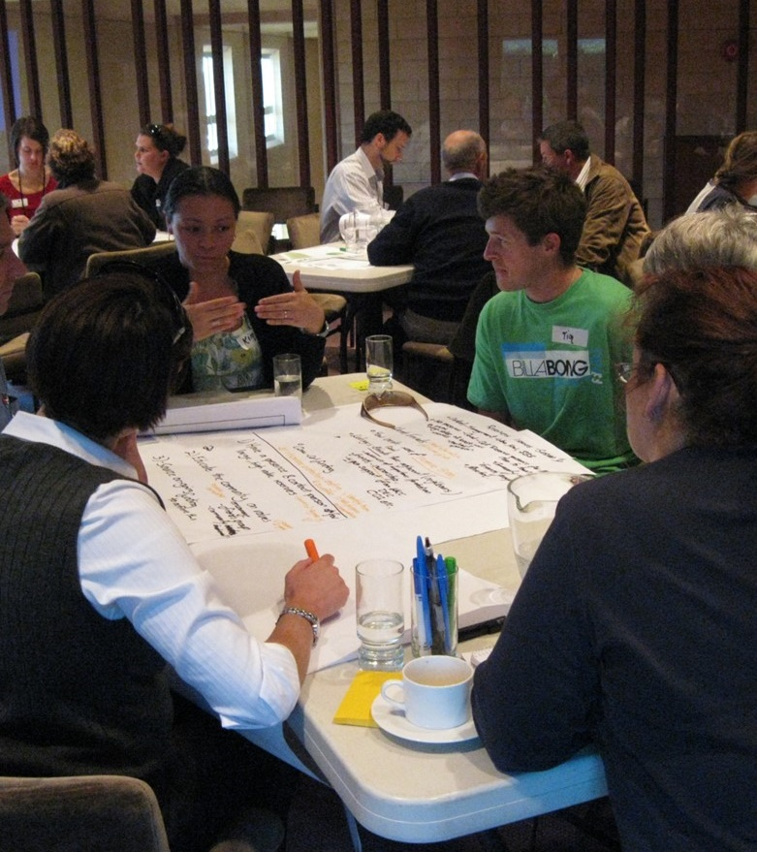

Scoping
Establish links with the Strategic Community Plan
Scope the resources required
Obtain Council support, including project plan for community engagement
Establish a Steering Committee (Terms of Reference)
Two Elected Members
Executive Managers (planning and asset management)
Community representatives
Set up a Working Group
Staff from planning, infrastructure/asset and natural area management
Photo: WALGA

Slide 15

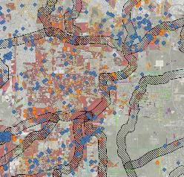

Identification and mapping of Local Natural Areas (LNA)
Collate spatial datasets that are representative of local natural area values, focusing on ecological criteria used in prioritisation.
Understand the limitations of these datasets.
Develop a vision and objectives for the Local Biodiversity Strategy (Link to the Strategic Community Plan and use Steering Committee/Working Group).
Many spatial datasets used to describe biodiversity are available via datawa.wa.gov.au , including mapping WALGA, 2021). You can use this dataset metadata to create an updated version when more current vegetation extent mapping becomes available.

Slide 16
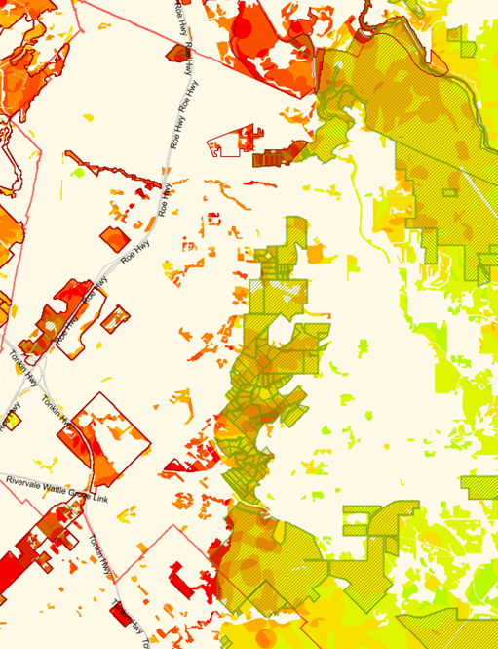

Prioritisation of Local Natural Areas
Use recognised ecological criteria to prioritise local natural areas (State supported categories):
Areas of recognised international, national or regional values which could include areas of scientific or evolutionary importance.
Representation of ecological communities including vegetation unique to a Local Government area
Diversity of priority species and communities
Rarity of threatened species and ecological communities
Maintenance of ecological processes or natural systems (connectivity)
Protection of wetland, streamline, estuarine and coastal vegetation.
An example of the application of ecological criteria in the Perth Metropolitan Region with an overlay of lands with varied protection (WALGA, 2018).
The 2020 version of this mapping is available via DataWA @ Western Australian Local Government Association - Organisations - data.wa.gov.au

Slide 17
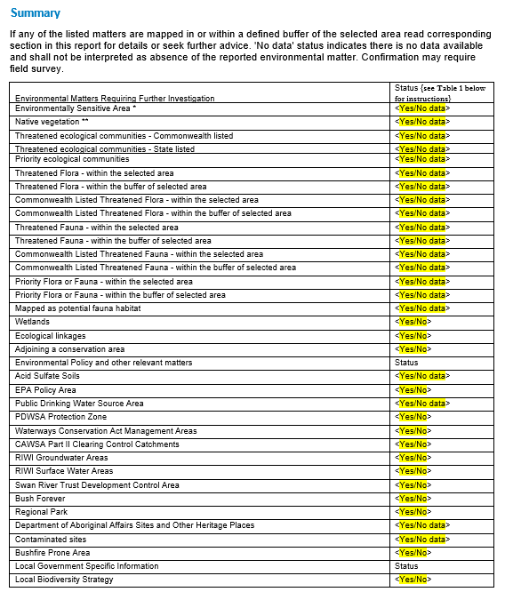
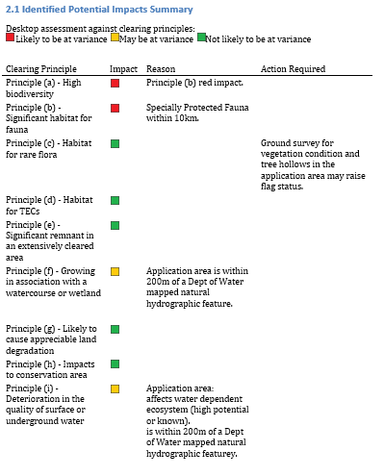
Prioritisation of Local Natural Areas
Other uses for the prioritisation criteria:
Checklist of environmental considerations for Local Government projects, facilitating timely avoidance and mitigation of impacts in project planning.
Create a mapping layer that represents known records for multiple values across natural areas to support land use planning.
Prioritise for management of lands vested in Local Government (these criteria overlap with the Natural Area Initial Assessment Templates).
Examples of checklists of environmental considerations

Slide 18
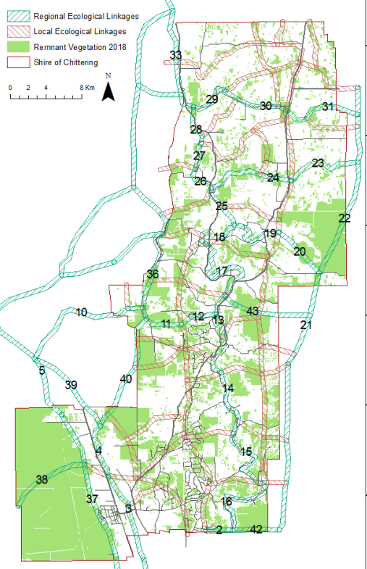
Prioritisation of Local Natural Areas
Identify ecological linkages / connectivity
  Using recognised mapping where available (www.datawa.wa.gov.au)
  Develop own by applying recognised principles (e.g. read metadata for the Perth Regional ecological linkages)

Slide 19
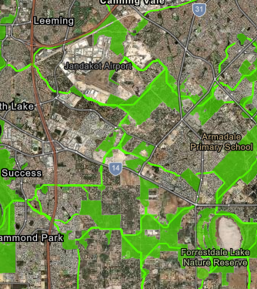
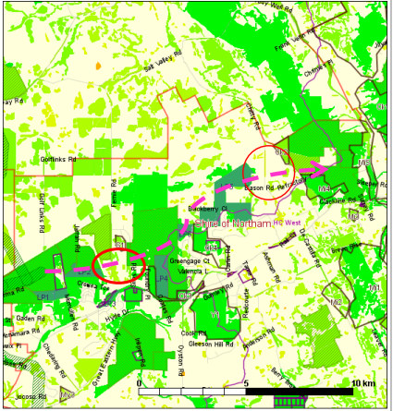
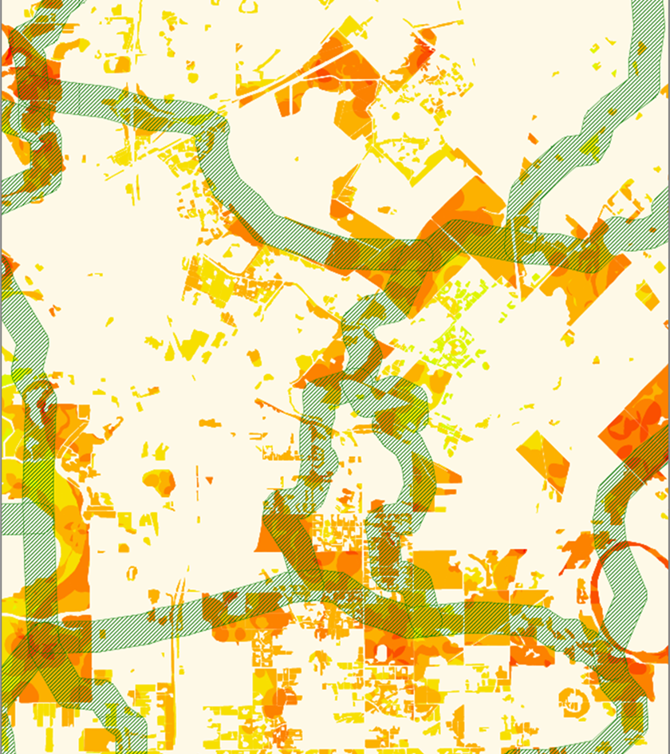
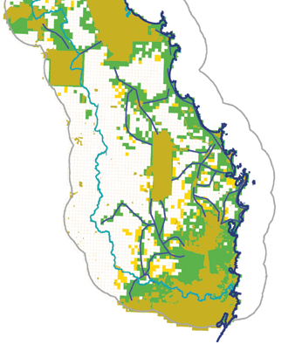
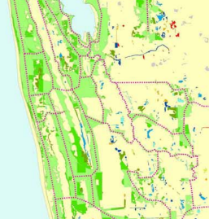
Vegetation classification by connectivity
(Shire of Northam, 2014)
Figures A & B show the same area in Perth with two types of linkages.
A: NatureLinks (O’Donnell, 2020) are based on automated least cost path modelling with the aim to connect protected areas.
B: Perth Regional Ecological Linkages (Del Marco et al, 2004) were manually mapped by ecologists to connect the full representation of ecosystems in the Perth Metropolitan Region .
A
South Coast Macro Corridors
(South Coast NRM, 2006)
South West Regional Ecological Linkages
(Molloy et al, 2009)
Stirling Ranges
B

Slide 20
Prioritisation of Local Natural Areas
Conservation significance & objectives
Regionally significant
Locally significant
Opportunities and constraints to protection & retention
Land tenure
Land use provisions
Bushland protection map
High conservation value areas needed to achieve conservation objectives/targets
Viability/resilience/connectivity
Ecological criteria:
Policies
Inform land use and project planning by identifying areas to avoid and those that will require further consideration/assessments prior approvals
Identify areas with good opportunities for conservation and restoration

Slide 21
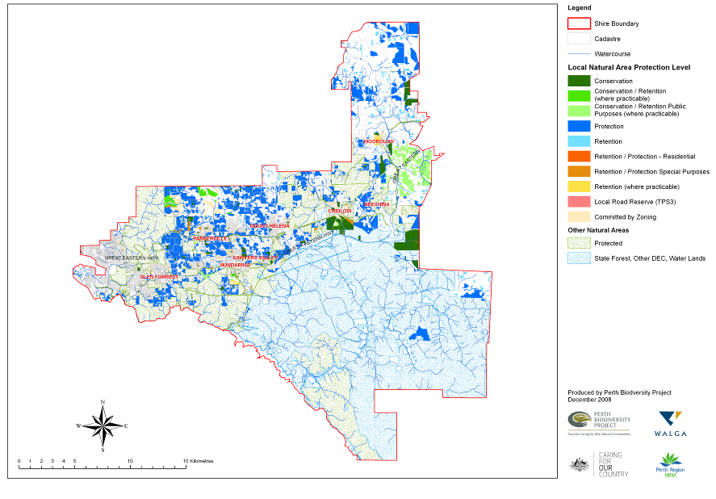
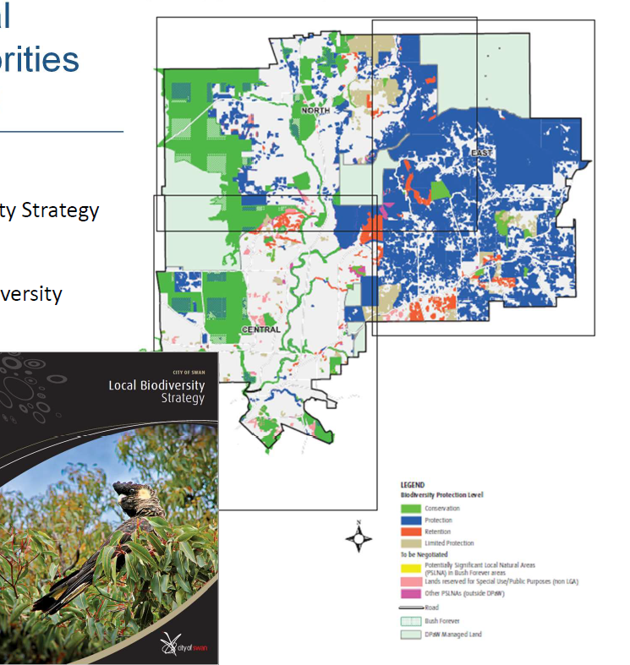
Examples of bushland protection maps
City of Swan (2004 & 2014)
Shire of Mundaring (2009 & 2023)
To help with implementation of conservation targets on private lands, the Shire introduced a very effective ‘Environmental Asset Inspections Service’

Slide 22
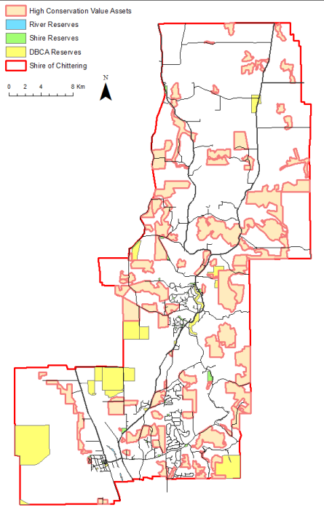
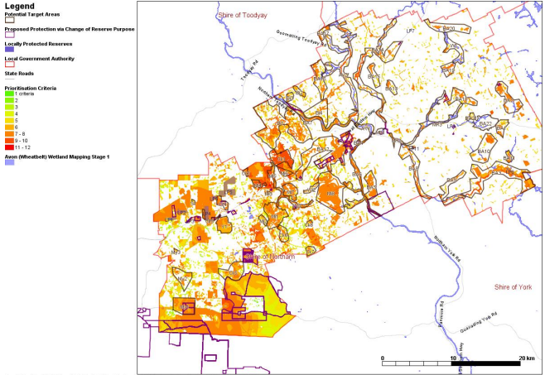
Examples of bushland protection maps
Shire of Chittering (2010 & 2022) High Conservation Value Assets including target areas for significant vegetation and reserves.
Shire of Northam (2014) Proposed target areas for significant vegetation and reserves where change in vesting purpose is proposed to increase protection, over 2013 native vegetation extent categorised by a number of prioritisation criteria met.
Source: Maps from local biodiversity strategies as published on the Shire of Northam and the Shire of Chittering websites, 2023
Notes:
3 Native vegetation with the number of prioritisation criteria met, Potential Target Areas and Selected Reserves.

Slide 23
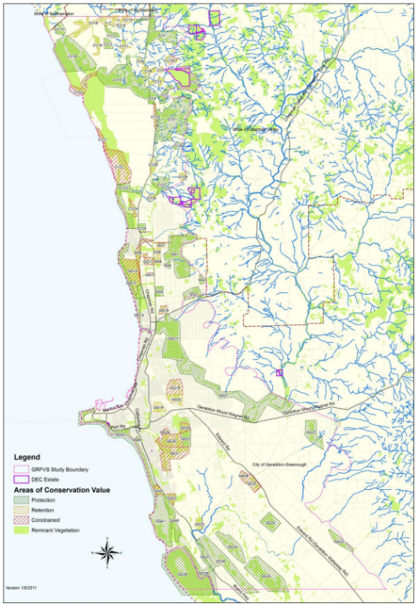
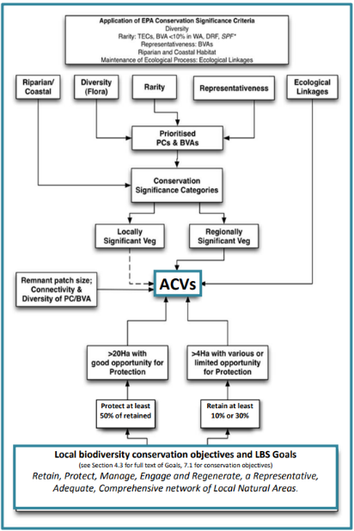
Examples of bushland protection maps
Geraldton Local Biodiversity Strategy (2013): Decision tree for identifying “Areas of Conservation Values (ACVs)”, including links to the local biodiversity objectives and the map of “Areas of Conservation Values” over mapped remnant vegetation.
Source: Geraldton local biodiversity strategy as published on the City’s website, 2023

Slide 24

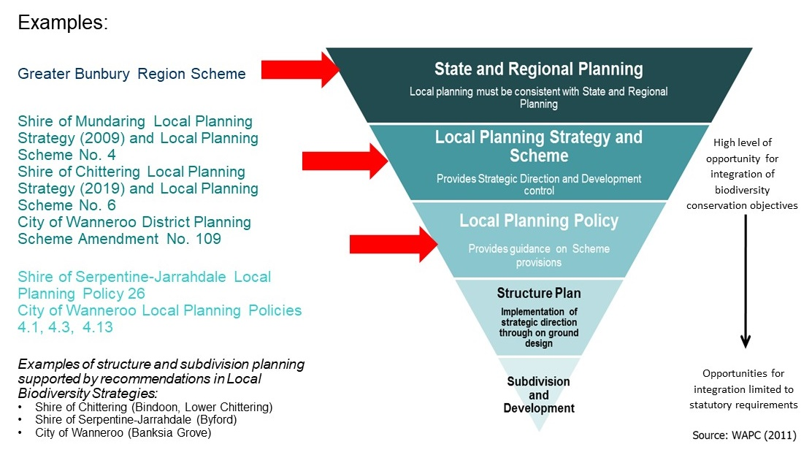
Protection Plan and Action Plan
Identify ways to increase the protection of high conservation value areas
Identify ways of integrating biodiversity conservation objectives into the local planning framework
Prioritise local government managed lands for further investigations (NAIA Templates) and management
Prepare a 5-10 years Action Plan with responsibilities assigned across the organisation.
Notes:
State recognition of local biodiversity conservation objectives is achieved through the endorsement of a local planning strategy by the WAPC when they become a component of a local planning strategy and are based on a local biodiversity strategies prepared:
in accordance with the endorsed methodology,
in consultation with relevant stakeholders,
endorsed by the Council.
The benefit of this approach has been demonstrated when a Local Government’s decision based on its Local Biodiversity Strategy have been tested in a case considered by the State Administrative Tribunal (Bernardini and WAPC [2010] WASAT 105) which upheld the WAPC’s and Local Government’s position on a proposed subdivision matter being contested by the proponent.

Slide 25
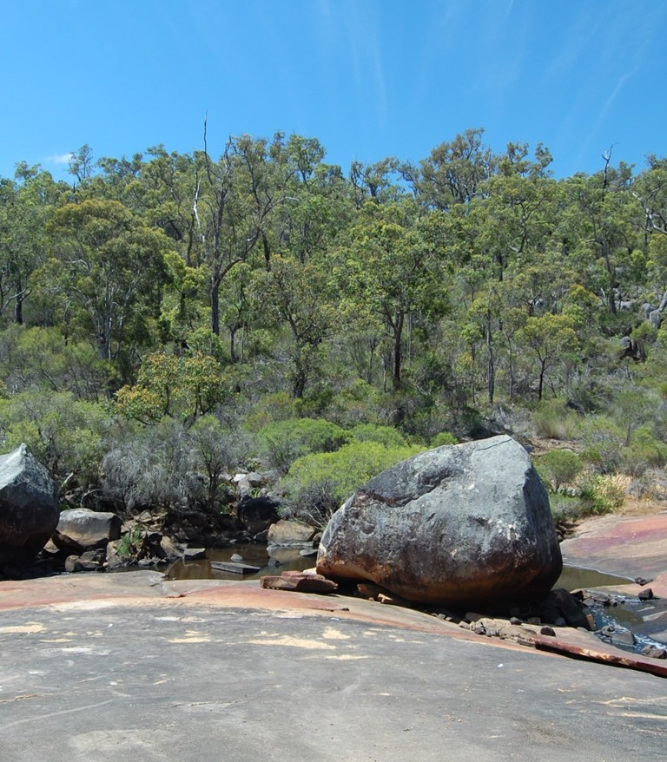



Action Plan
Integration into local planning
Facilitation of reserve vesting change
Internal mapping systems
Local Government managed lands
Land purchase
Project planning checklist
Code of conduct for contractors
Community engagement and volunteer support
Private landholder incentives
e.g. Environmental Assessment Service
Photo: WALGA

Slide 26
Local Government
Strategic Community Plan
Local Biodiversity Strategy
Local Planning Strategy, Scheme and Policies
Local Laws
Reserve Management Plans
Land tenure change/land aquisition
Environmental Management Systems
Council Policies
Water Management Strategy
Waste Management Strategy
Community Wellbeing Strategy
Urban Forest Strategy
Support to community volunteers and private landholders (Environmental Assessment Service; grants; volunteer insurance)
Strategies/Plans addressing specific issues
Implementation tools
Summary - Integrations of biodiversity considerations in Local Government operations
Action Plan
What can Local Governments influence?
Strategic land use planning
Land reservation/zoning
Development control
Reserve vesting, land acquisition, management
Project delivery
Community awareness and incentives
Increased biodiversity protection/retention
Threat management

Slide 27
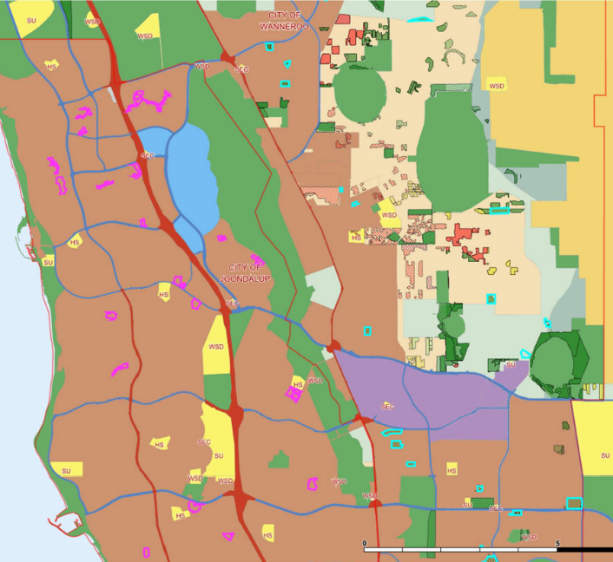
Examples of integrations of biodiversity considerations in Local Government
Examples of Local Governments which adopted Local Biodiversity Strategies and subsequently introduced into their Local Planning Schemes zones or local reserve categories that protect biodiversity (as at 2023):
Shire of Mundaring
City of Wanneroo
Shire of Serpentine-Jarrahdale
Shire of Chittering
City of Greater Geraldton
Shire of Northam
City of Joondalup
City of Swan
Local conservation type reserves (magenta and aqua boundaries) over Metropolitan Region Scheme land use categories. Source: WALGA, 2021
Notes:
8 LGAs following adoption of LBS introduced a conservation type local reserve classification into their Local Planning Scheme.
Examples of native vegetation in local ‘Conservation’ reserves*
Shire of Mundaring (LBS adopted in 2009) 6,240ha
Shire of Serpentine-Jarrahdale (LBS adopted in 2008) 300ha
City of Wanneroo (LBS adopted in 2011) 537** of targeted 1,115ha
City of Joondalup (LBS adopted in 2010) 74.7ha
City of Nedlands 4.6ha
*based on 2020 vegetation extent
** status in 2016
There are other LGAs that have local planning scheme provisions designed to protect significant native vegetation and biodiversity its supports – e.g. AMR have

Slide 28
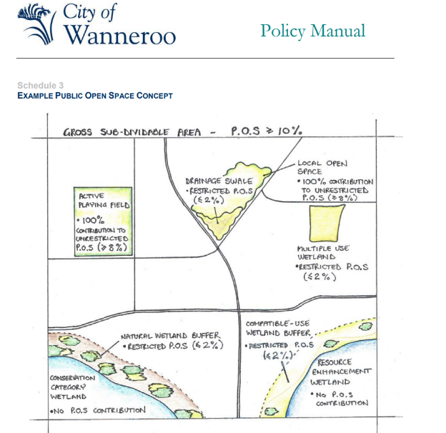
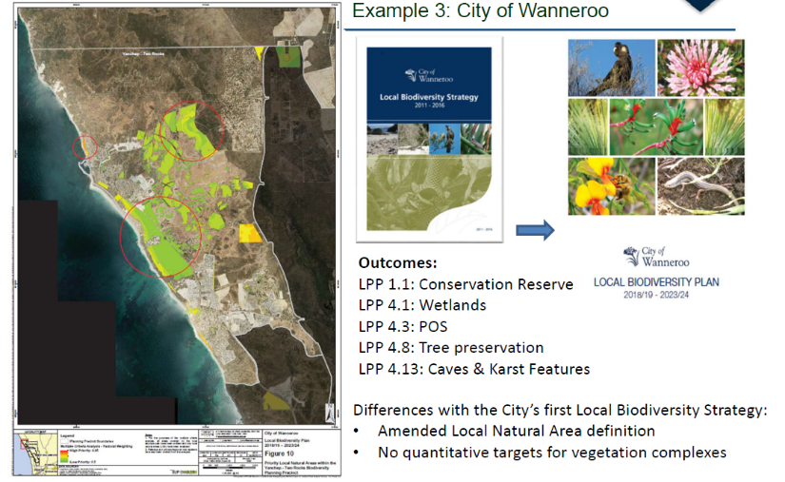
Examples of integrations of biodiversity considerations in Local Government
City of Wanneroo (2011 & 2018)
Nature POS
3.8 A minimum of three percent (3%) of the gross sub-divisible area shall be provided as POS for the purposes of conservation and recreation where any of the following significant natural assets exist:
• Threatened and Priority Ecological Communities;
• Declared Rare and Priority Flora Species;
• Specially Protected and Priority Fauna Species;
• Matters of National Environmental Significance (as per The Environment Protection and Biodiversity Conservation Act 1999);
• Wetlands (in accordance with Schedule 1);
• Karstic features e.g. caves and pinnacles;
• Vegetation complexes with less than 30% of their original extent remaining (as detailed in the City’s Local Biodiversity Strategy);
• Coastal Vegetation;
• Significant Trees (as defined by the City’s Tree Preservation Policy).
3.9 Where less than 3% of the subdivisible area has natural assets worth conserving, the maximum shall be retained.
Notes:
The City was one of the 3 LGAs piloting the process described in the WALGA published Guidelines, including specific targets
Due to the uncertainty over how LBS will be considered by the State – it was not until 2011 that the LBS was adopted by the Council.
Delivered several positive outcomes:
– several LPPs to provide guidance on how the City will apply discretion in decision making
- Protection target set at 1,115ha – of this 537ha protected in 2016
- Significant increase in funding for reserve management, including employment of staff with specific natural area management expertise and Environmental planning.

Slide 29
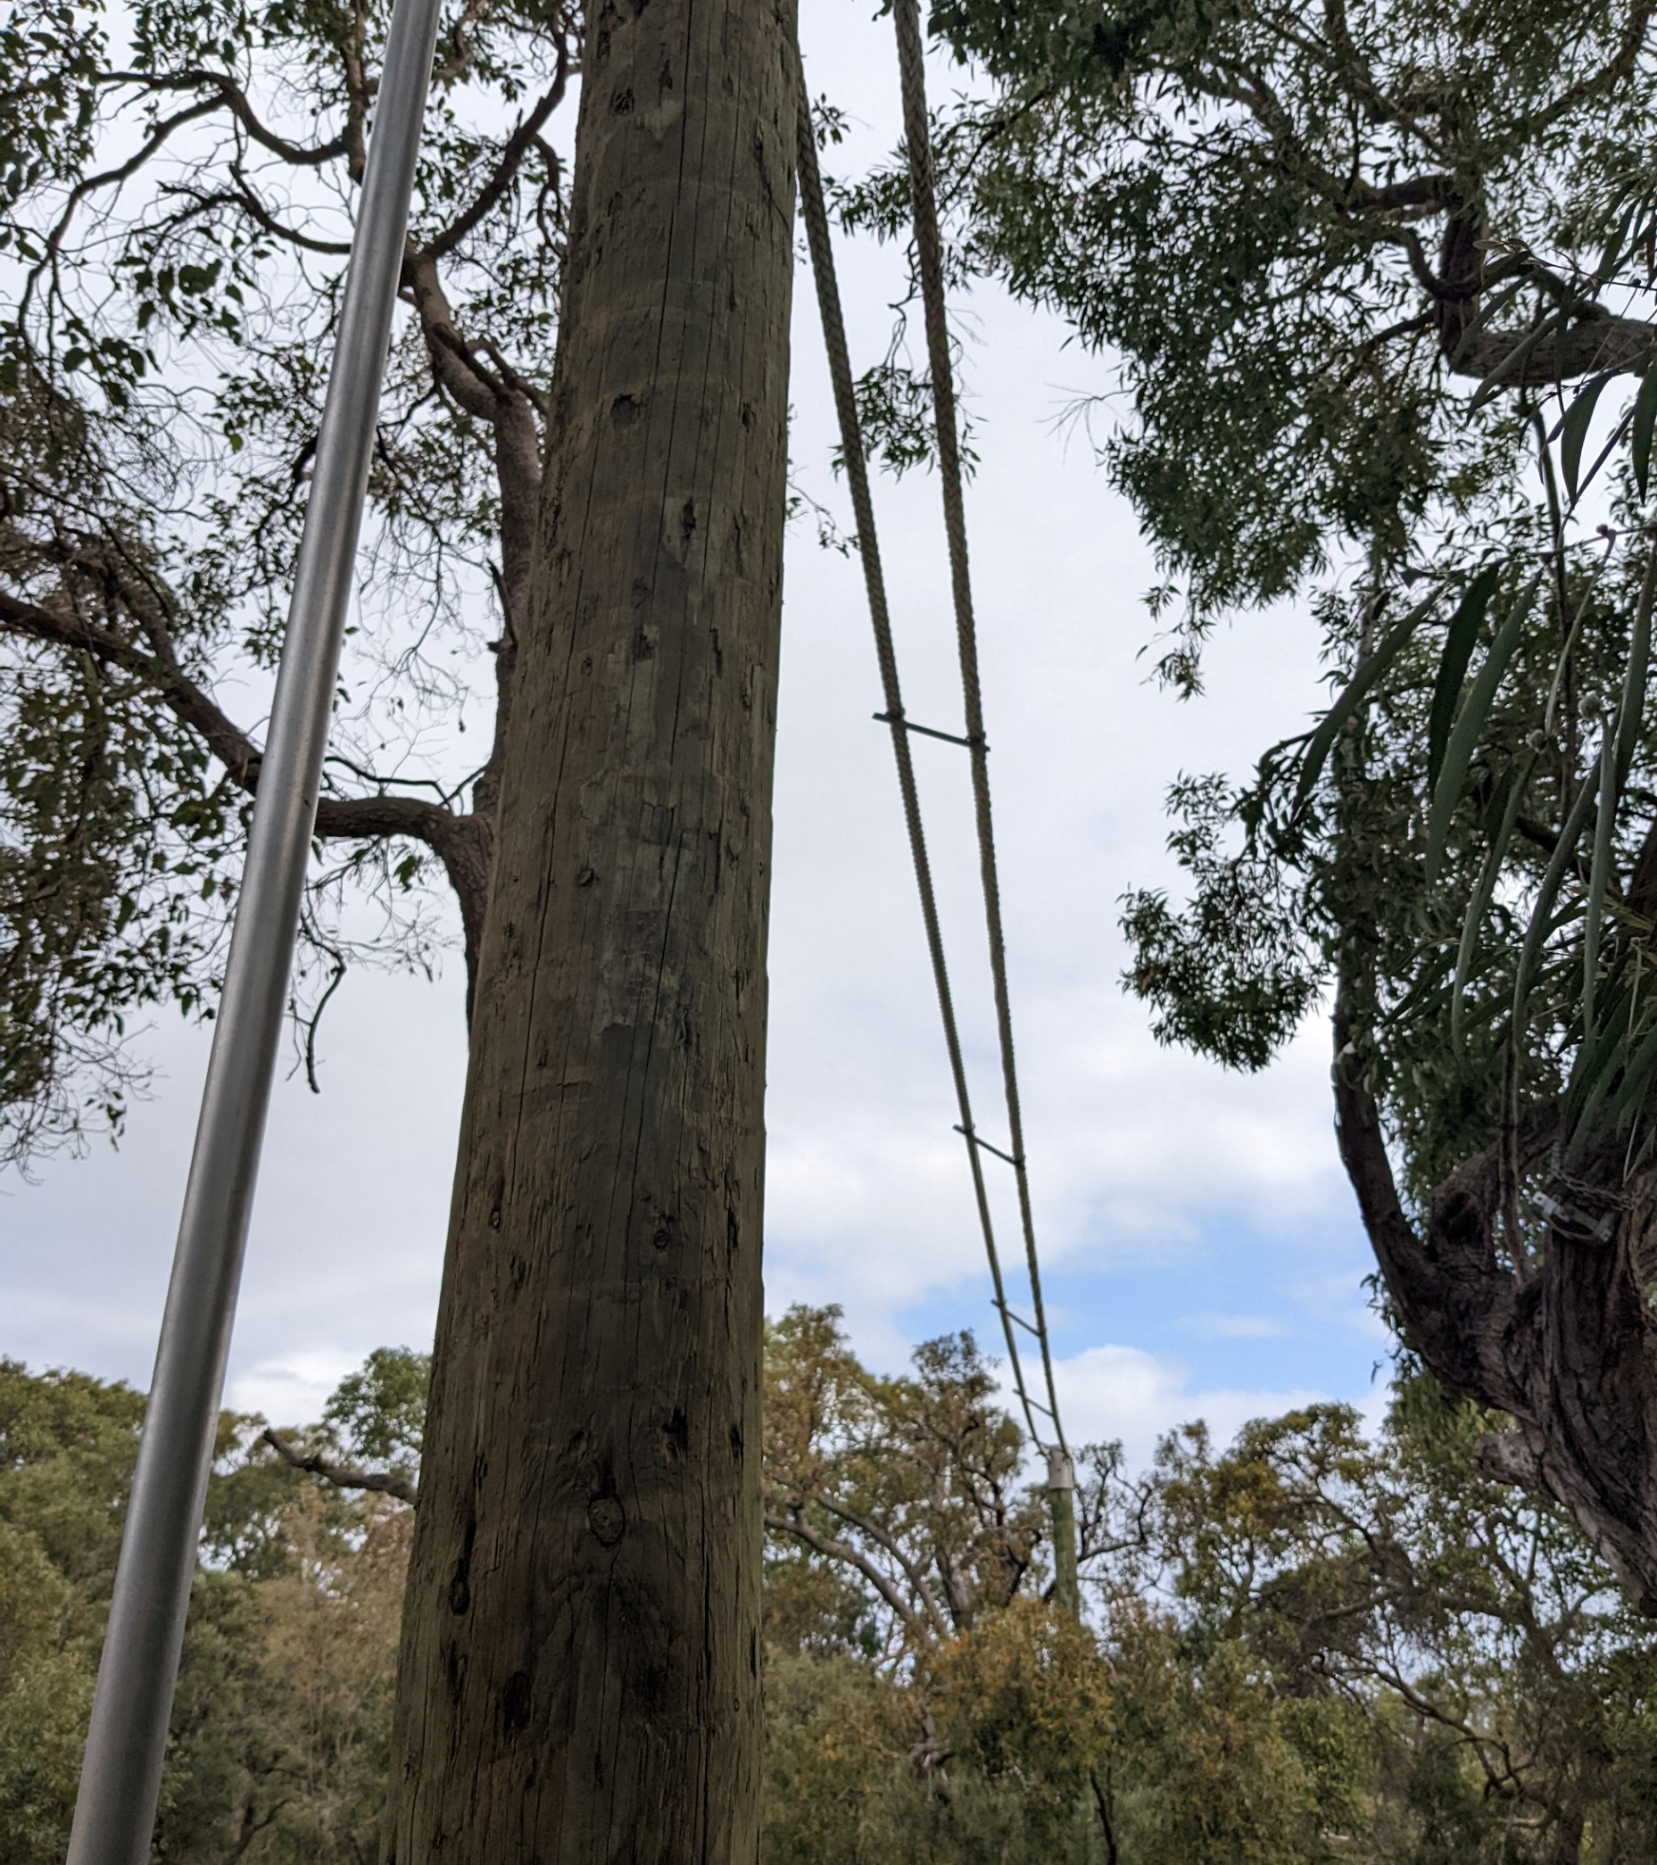
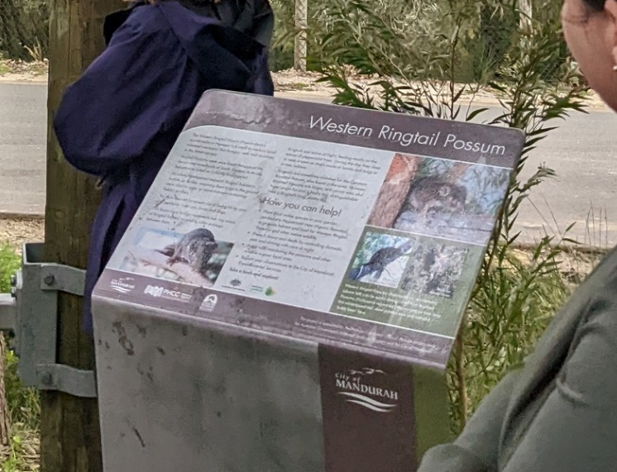
Examples of integrations of biodiversity considerations in Local Government
City of Mandurah – example of a bridges that links a newly created natural area reserve with other natural areas of Western Ringtail Possum habitat
Photo: WALGA

Slide 30


Consultation, Implementation and Review
With Council support, invite public comments on draft Local Biodiversity Strategy
Review feedback and make changes to the Draft if required
Seek Council support in adopting the final Local Biodiversity Strategy with an Action Plan.
Review every 5-10 years to adapt prioritisation and implementation actions.

Slide 31
Benefits of Local Biodiversity Strategies
Early consideration of biodiversity in land use planning
Support for land use/development application
Increased transparency on what ‘significant’ vegetation or natural area means locally and where these ‘significant’ areas are located
Local protection targets contribute to improved conservation status of biodiversity at regional levels
Identification of opportunities for restoration (local reserves, ecological linkages)
Mainstreaming biodiversity across Local Government operations and meeting regulatory requirements.

Slide 32
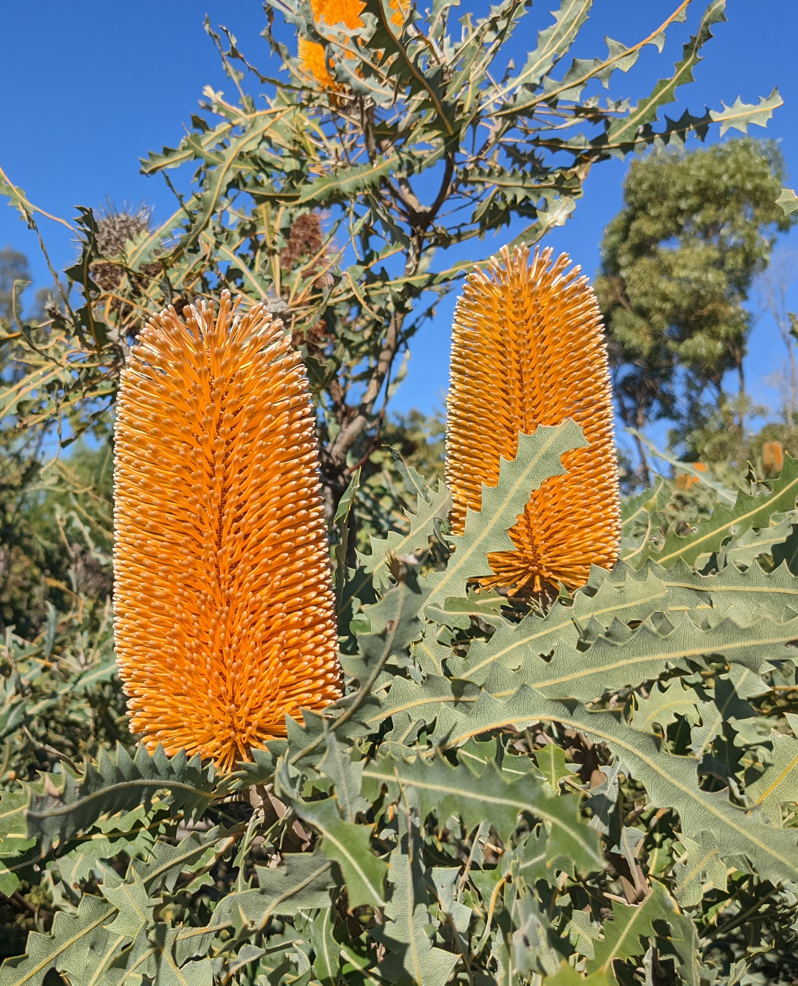
Contribution to conservation
In Perth and Peel, 60% of remaining vegetation is in 8 Local Government areas with quantitative targets for protection adopted via Local Biodiversity Strategies (2014)
Implementation of targets for the Darling Scarp vegetation complex could prevent its potential decline below the 30% threshold at bioregion level
Shire of Mundaring – increased regional protection status for two vegetation complexes by 1%
Shire of Augusta-Margaret River - Natural areas representative of eight vegetation complexes are protected only through the Shire’s Local Planning Scheme provisions of three zones
Photo: WALGA
Notes:
In 2014, 60% - since than City of Wanneroo dropped targets but reviewing this position for the latest update to be completed in 2024. City of Wanneroo is also a good demonstration of the benefit
The Shire of Chittering is another good example – while protection via local reserves is limited – the LBS lead to identification of lands where intensification of land use should be avoided and inclusion of LPS provisions/conditions to support private land conservation – acceptance to a covenanting program is a condition of a subdivision.
Informed State’s selection of properties for offsets.
Mundaring - In 2020, 6,240 hectares of native vegetation were protected via the Shire’s Local Planning Scheme Conservation Reserve provision. This was significantly higher than the 2009 LBS goal for conservation ‘To have 1065ha in the Conservation Category,…and endeavour to increase to 1570ha’.
Several vegetation types have naturally limited distribution, in some instances contained within a single Local Government area. In the Shire of Augusta-Margaret River, of the 57 vegetation complexes mapped in the Shire, 33 are not mapped outside the Shire boundary. Natural areas representative of eight vegetation complexes are protected only through the Shire’s Local Planning Scheme provisions of three zones: Bushland Protection, Leeuwin-Naturaliste Ridge Conservation and Southern Ocean Foreshore Protection. In addition, the Shire’s Local Planning Scheme No 1 (2022) includes development controls on lands within identified Regional Environmental Corridors.

Slide 33



Local Biodiversity Planning Summary
33
Strategic Benefits
Resources
Local Biodiversity Strategy
Biodiversity Outcomes
An instrument for delivering on Strategic Community Plan objectives
Transparency in decision making
Early consideration of biodiversity in Local Government operations (planning & asset management)
Local Government Guidelines for Biodiversity Planning
NAIA Templates
Mapping data
Technical support/advice
Focus on Local Natural Areas
Consistent criteria in the regional context
Bushland protection map
Action plan for relevant services/operations
Improved biodiversity outcomes at local and regional levels
Opportunities for increasing community awareness

Slide 34
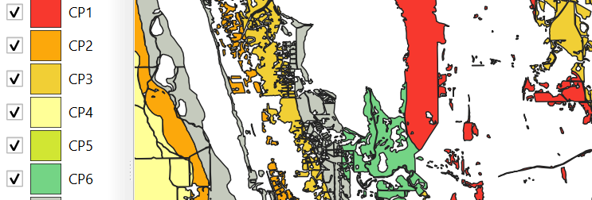
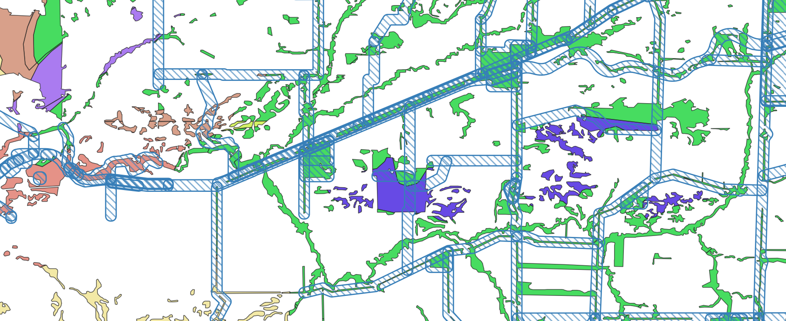
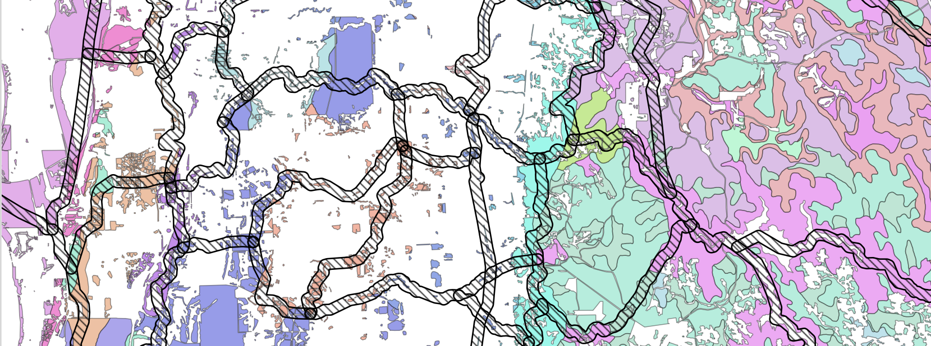
WALGA Support
Conservation priority vegetation complexes, WALGA 2021
Identification of Local Natural Area and mapping data for local natural area prioritization
(Download mapping layers via DataWA @ Western Australian Local Government Association - Organisations - data.wa.gov.au
Conservation priority local roads and reserves (WALGA, 2023) over 2020 vegetation extent by vegetation associations, WALGA 2021
Advice on the local biodiversity conservation planning process and on integrating biodiversity into land use planning
Training module on Environmental Matters for Elected Members and Local Government Officers
Perth Regional Ecological Linkages (2004) over 2020 vegetation extent by vegetation complexes, WALGA 2021

Slide 35


Disclaimer
At WALGA, we've made every effort to ensure that the material contained on our website is accurate, current and reliable at the time it was created or last modified.
While the material on this resource is compiled with due care, WALGA does not warrant or accept liability with regards to the accuracy or completeness of the material. As such, no reliance should be made by the user on the material who should carefully assess the relevance and accuracy of that material, including seeking confirmation from the originating body.
The information delivered to you via any externally hosted website is produced and managed by the website owner. All care has been taken to ensure validity of these external sites, however WALGA cannot be held responsible for any misrepresentation of information found on any external websites.
If you wish to clarify anything about this site or have concerns regarding your privacy, please contact us.
Copyright
All material that appears in this presentation, including content, graphics and audio is protected by the operation of the Copyright Act 1968, and is owned by the WALGA unless otherwise referenced as being from another source. Materials contained here can be reproduced for personal and non-commercial use, without permission providing it remains unaltered in its original form. Should you wish to reproduce material that is for commercial or non-personal use, you can request permission to do so by contacting us.
Contact
For further information email to environment@walga.asn.au
Resources
To download resources supporting local biodiversity planning visit WALGA’s website
To download mapping data, go to
Western Australian Local Government Association - Organisations - data.wa.gov.au
This Project is supported by funding from the Western Australian Government’s State NRM Program

