Slide 1


Work Health & Safety Legislation and Bush Fire Brigade Volunteers
Webinar
Wednesday, 9 February

Slide 2

Acknowledgement of Traditional Owners
WALGA would like to acknowledge the many traditional owners of the land on which we work throughout Western Australia.
We pay our respects to their Elders, past and present.
Pictured right: Artwork by Jade Dolman, a young Whadjuk/Ballardong Nyoongar, Eastern Arrernte, Irish woman from Perth.

Slide 3
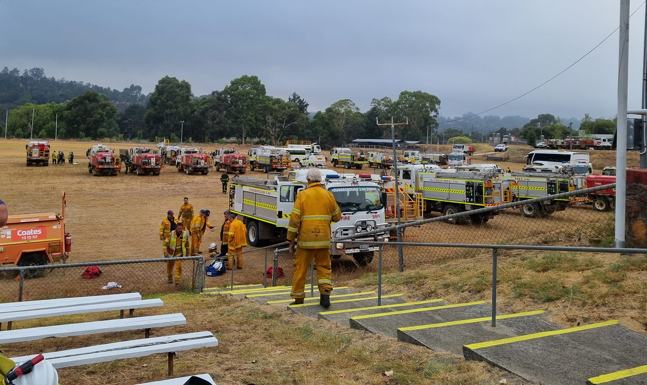
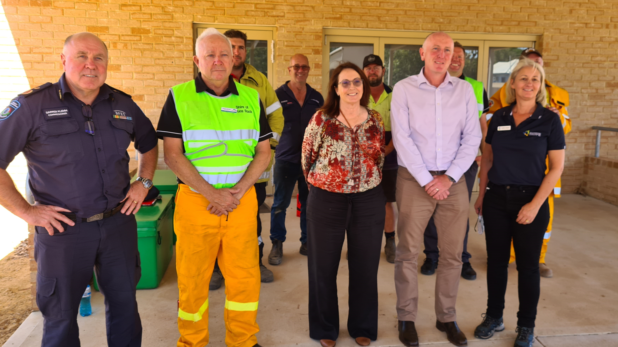
Introduction
111 Local Governments Manage BFBs
536 BFBs
+20,000 BFB Volunteers
Shift change at Bridgetown on Sunday, 6 February.
Courtesy of the Vasse Bush Fire Brigade Facebook Page
A/WALGA President Karen Chappel with DFES Commissioner Darren Klemm, Minster for Emergency Services Stephen Dawson and Local Government Representatives on Tuesday, 8 February.

Slide 4
Housekeeping
Please mute your microphones
Questions are welcome in the chat and answers will be facilitate during the webinar
The presentations from the webinar will be made available on the WALGA website

Slide 5
Program
New Work Health and Safety Legislation
Bill Mitchell, Department of Mine, Industrial Regulation, and Safety (DMIRS)
Protection for Bushfire Brigade Volunteers
Charissa Chung, LGIS
Q&A
DFES Volunteer Hub Walk Through
Andrea Dinse, DFES
Q&A

Slide 6
Bill Mitchell, DMIRS

Slide 7


Slide 8
Work Health and Safety Regulations 2022
Bill Mitchell – General Manager WHS Legislation Project

Slide 9
Introduction
Topics
  Person Conducting the Business or Undertaking
  Officers and their duties
  Workers
  Penalties
  Volunteers and Volunteer Associations.
  Industrial manslaughter

Slide 10

Person conducting a business or undertaking – PCBU (s.5)
Primary duty of care
Businesses or undertakings conducted:
  alone
  with others
  for profit or not-for-profit
Exclusions
  volunteer association (s. 5(1)(7))
  workers
  local government member (s. 5(1)(5))

Slide 11

Officers (s.4A)
Makes, or takes part in, decisions about all or part of the PCBU.
Due diligence (s.27 Duty of Officers
  keep your WHS knowledge current
  know WHS hazards and risks
  proper resourced and processes to manage WHS risks
  reporting processes for incidents, hazards and other WHS issues, and verify.
Job Title

Slide 12

Workers (s.7)
Means a person working for a PCBU:
  employee
  contractor or subcontractor
  employee of a labour hire company
  outworker
  apprentice or trainee
  student gaining work experience
  Volunteer
Duties – Reasonable (s. 28)

Slide 13

Volunteers and volunteer organisations
Worker - without payment or financial reward
Volunteers cannot be prosecuted for failing
to comply with duties except as worker and other person (s.28 & s. 29)
Volunteer Association – No employees

Slide 14
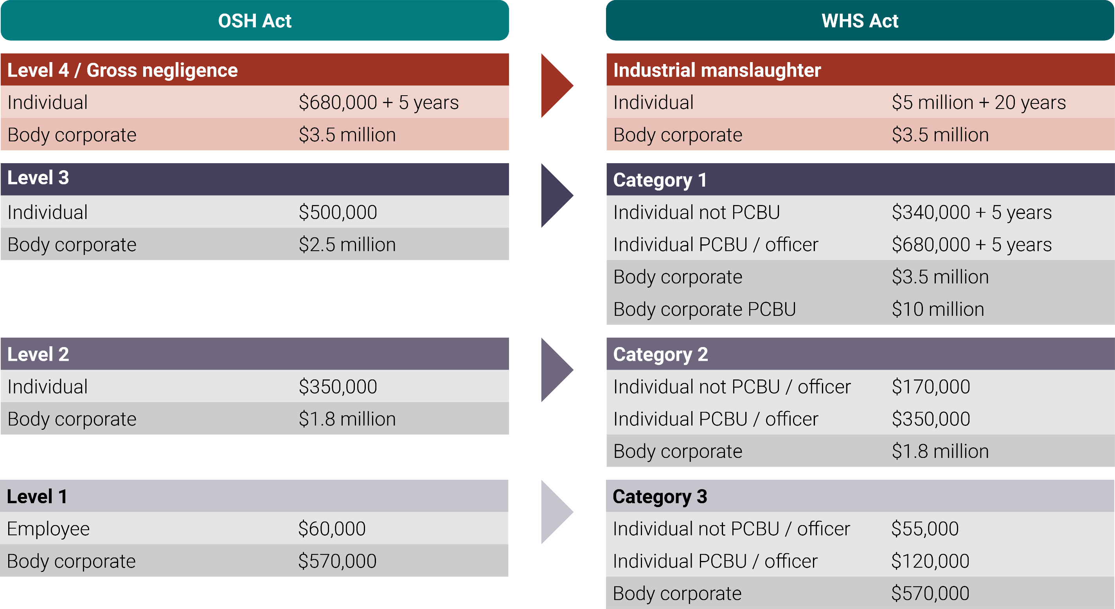

Slide 15
Industrial manslaughter – crime (s.30A)
Five elements must be proven, beyond reasonable doubt…
  Person had a health and safety duty as a PCBU
  Caused death of an individual through an act or omission
  Failed to comply with their health and safety duty
  Knew it was likely to cause death or serious harm of the individual
  Disregarded likelihood of death or serious harm
Officer: Must prove the PCBU’s conduct was due to the
officer’s neglect, consent or connivance.

Slide 16
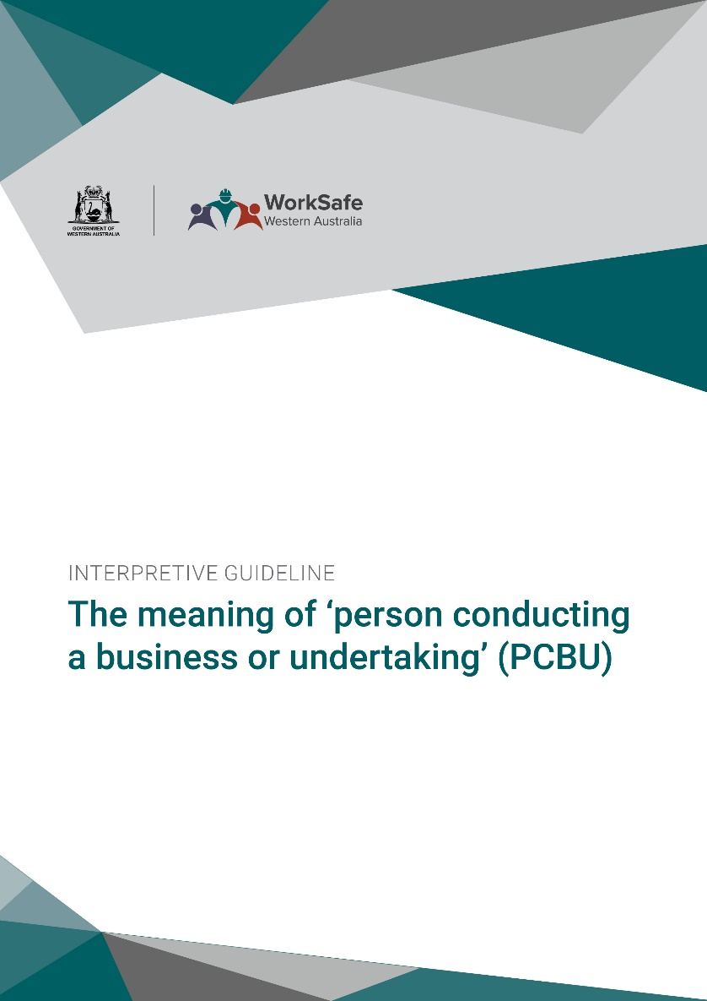
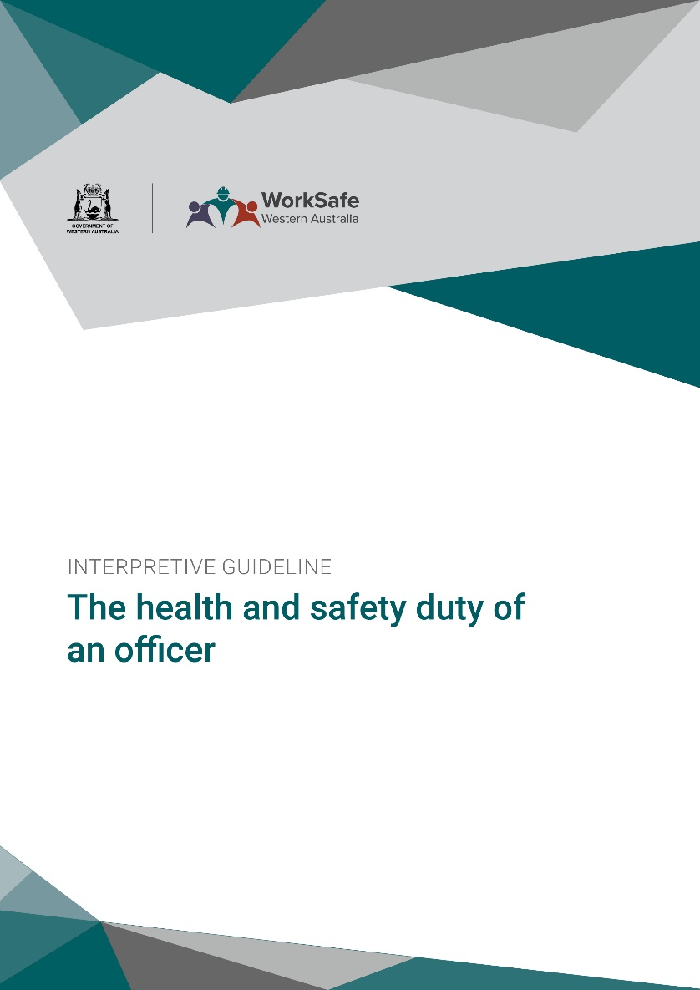
Publications - Interpretive Guidelines and Guides

Slide 17




Stay in touch
The Department provides a range of newsletter and information products to keep you up to date.
www.dmirs.wa.gov.au/subscribe
www.dmirs.wa.gov.au/WHS
@dmirs_wa @WorkSafeWA
WorkSafe WA
@WorkSafeWA
WHSReform@dmirs.wa.gov.au

Slide 18

Protection for LG Bushfire Brigade Volunteers
Prepared by Carrisa Chung
February 2022

Slide 19

Personal Injury
Benefits identical to the Workers Compensation Injury Management Act 1981 schedule of benefits
Injury Management services
Return to Work/Pre-injury duties

Slide 20
Statutory Liability
(innocent breach of statutes)
Emergency Defence Costs
Work Health and Safety Defence Costs

Slide 21

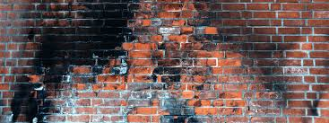
Liability
Third party Personal Injury
Third party Property Damage

Slide 22
So what you should be considering now
Where reasonable and practicable for a local government to:
1. Ensure volunteer work areas are free of hazards;
2. Ensure that volunteers understand their duties and responsibilities;
3. Develop policies and procedures governing on-boarding, screening, training guides and supervision of volunteers
4. Allow sufficient resources to ensure the effective management and development of bushfire brigade volunteers
5. Communicate and consult with volunteers on occupational safety and health issues; and
6. The provision to induct and train/instruct volunteers in their task.

Slide 23

Thank you for your time

Slide 24
Q&A

Slide 25
Andrea Dinse, DFES
https://volunteerhub.dfes.wa.gov.au/logon

Slide 26
Q&A

Slide 27
CONTACTS
Department of Mines, Industrial Regulations, and Safety (DMIRS), Bill Mitchell
General Manager, Regulatory Support Division
(p) +61 8 6251 2306 (e) bill.mitchell@dmirs.wa.gov.au
LGIS, Carissa Chung
Portfolio Manager, WorkCare Services
(p) (e) carrisa.chung@lgiswa.com.au
DFES Volunteer Hub, Andrea Dinse
Volunteer Communications Coordinator
(p) 9395 9902 (e) andrea.dinse@dfes.wa.gov.au
WALGA, Susie Moir
Resilient Communities Policy Manager
(p) 9213 2058 (e) smoir@walga.asn.au

