Slide 1
ABORIGINAL HERITAGE ACT 1972
WALGA Webinar
28 November 2023

Slide 2
Aboriginal Heritage Act 1972 (AHA)
Provides for the statutory protection of Aboriginal heritage sites
Establishes the criteria (s5) for what constitutes an Aboriginal site:
(a) place of importance and significance where objects connected with traditional cultural life, past or present
(b) any sacred/ceremonial site of importance & special significance
(c) any Aboriginal heritage place of State importance & significance
(d) any place where objects traditionally stored or been taken
Sets out approvals processes (ss16 & 18) for land uses that might cause harm
Establishes the ACH Committee
Supported by AH Regulations 1974 that set out processes and procedures as well as establish minor offences (regs 7 & 10)
Reg 10 guidance to be developed for when reg 10 vs s18 approval required, process to be followed, timeframes

Slide 3
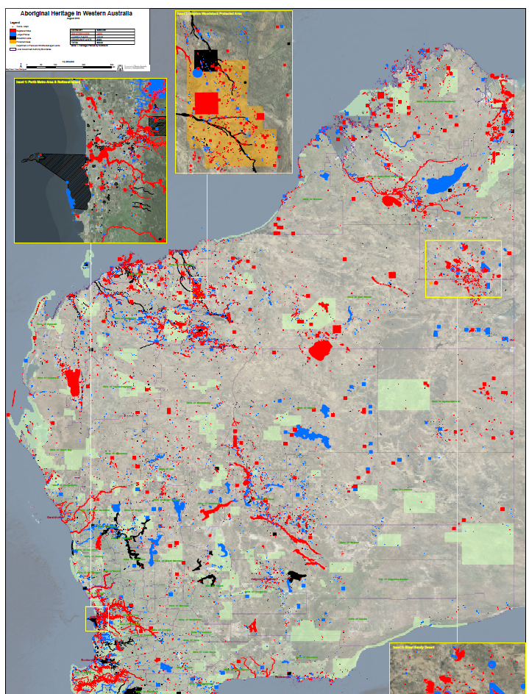
ACHIS (Aboriginal Cultural Heritage Inquiry System)
DPLH holds information on approximately 36,000 AH places:
14,000 registered sites
16,000 lodged places
6,500 stored data
Of 14,000 registered sites:
7,700 have artefact scatters
3,600 are art sites (engravings or paintings)
2500 sacred/ceremonial
800 State significance
AH not need to have been recorded for AHA to apply
Notes:
All Aboriginal sites are protected whether or not they have been recorded and reported to the Department.
If

Slide 4
AH Legislation Amendment and Repeal Act 2023
Came into effect on 15 November
Repealed ACH Act 2021 and associated Regulations
Key amendments to reinstated AHA :
native title parties have same right as landowners for SAT review
‘gag clauses’ in agreements of no effect
new information requirements for landowners and reconsideration of consent by Minister
Premier call-in power for SAT applications where State or regional importance;
section 18 consents transfer where change in land ownership;
new ACH Committee to be skills-based, male and female Aboriginal co-chairs, majority Aboriginal

Slide 5
AH Amendment Regulations 2023
Identification of ‘native title parties’
Procedures and statutory timeframes for s18 process including:
Committee recommendations
Committee requests for further information
SAT applications for review
New information including Minister’s decision
Premier’s call-in power and determinations re SAT applications
Change in land ownership
Committee procedures
New and increased penalties

Slide 6
AH Transitional Regulations 2023
Procedures for Committee for ancestral remains or secret & sacred objects
Transitioning of permits and plans to s18 consents and applications transitioned as s18 notices.
Defences for activities undertaken under the 2021 Act
Transfer of information from Directory to Register
Investigations for offences under the 2021 Act
Actions and records of the ACMC to transfer to the new ACH Committee

Slide 7
AH Fees Regulations 2023
Set out the fees for section 18 notices and section 16 applications
Commercial and Government proponents:
$250 application fee
$5,096 multiplied by the number of identified places (s18) and proposed investigation sites (s16)
Individuals, small business and not-for-profit organisations: $250 application fee only
Exemption for Aboriginal corporations undertaking NFP activities
DG power to waive, reduce or refund fees or extend time to pay
e.g. disproportionate cost impacting project viability

Slide 8
AHA Guidelines
Steps for landowners to assess potential for impact
What happens if there is an Aboriginal site
Section 18 application process, including information required
Timeframes
Consultation
ACH Committee and Minister roles
Obligations to report
Consent holder requirements re new information
Right of review and Premier’s call-in power
Transfer of consent on change of land ownership

Slide 9
Consultation Policy
Government’s expectations for consultation prior to application
Provides legislative context
Sets out guiding principles and other considerations
Outlines when and why consultation should occur
Establishes consultation standards:
full disclosure
alternative locations/methods
how to engage
non-disclosure of culturally sensitive information
Who is to be consulted
Evidence of consultation

Slide 10
NT Party Capacity Building Program
Funding open to native title parties as defined under the AHA
Focus on ability to:
engage with and advise proponents proposing to undertake activities that may result in harm to Aboriginal heritage
participate in proponents’ consultation for s18 applications
record and report Aboriginal sites where required for s18 notice
Complement training being developed with TAFE

Slide 11
Heritage Survey Program
Purpose is to:
identify location of Aboriginal heritage
check mapping accuracy of known sites and places
confirm where there’s no heritage
Focus on unsurveyed and/or high priority areas of the State
Aboriginal participation and landowner consent required
Program and prioritisation framework to be designed and developed with Aboriginal groups.
Complemented by capacity building program

Slide 12
FURTHER INFORMATION
Further information on the changes at DPLH website
Sign in or register to access the ACHknowledge portal to:
Request Advice
Lodge Applications for ACH related processes
View the progress of your applications
Update your contact details
Contact Aboriginalheritage@dplh.wa.gov.au

